Slide 1
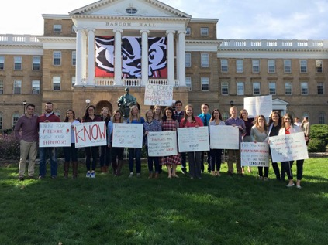
Wisconsin Society of Pharmacy Students
General Meeting
January 30th, 2018
5:45 pm

Slide 2
Distinguished Member Punch Card
Opportunity to get more involved in WSPS and obtain a certificate!
Criteria (complete by May 2018)
Attend all remaining general meetings
Excuses with justification possible
Participate with 3 operations
Attend a national or local meeting
APhA Annual, ASHP Midyear, PSW Legislative Day, PSW Educational Conference, PSW Annual
Volunteer at or attend 2 events beyond COPs requirements
Attend/participate in 1 miscellaneous event

Slide 3
ASHP January Updates
Spring P&T Committee Sign-Ups
ASHP Advocacy Bootcamp in Washington DC is February 26th-27th. Registration is open!
Residency Newsletter
Tips for students on how to plan/prepare for residency and make your CV stand out
Targeted to pharmacy students at all levels!
Pharmacy Student Forum Advisory Groups
Get involved with ASHP student activities on a national level
Applications due May 31st this year
I would highly recommend- great way to meet students from around the country!
Notes:
-Spring P&T Committee meetings- great if interest in PBMs/formulary management/etc., can use to determine if you would like to do IPPEs at a similar site!
-Advocacy Bootcamp-first day is a conference with sessions on advocacy and conferencing on how to talk to legislators, second day you go to the capital in DC to talk to legislators/aides!
-Residency newsletter- new thing that the Leadership Development student advisory group worked on this year, take a look if you’re interested! It gives tips and information for students DPH1-DPH4!
-Student Forum Advisory Groups- great opportunity to get involved, I was able to participate in the leadership & development group this year and contributed to the residency newsletter and an ASHP foundation program, I met a LOT of other students at midyear through participation!
-Will send out more information and links to the above opportunities in an email tomorrow- watch for it if you’re interested and as always let me know if you have any questions!

Slide 4
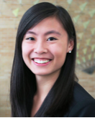
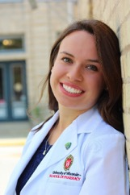
White Coat Ceremony Committees
Come learn about the different committees that help make the White Coat Ceremony a success!
White Coat Ceremony – April 22, 2018
Info Meeting: February 7, 2018 – 1PM right after Path!
Room: 1116
Committees
Fundraising, Coats, Ceremony, Slideshow
Keep taking pictures for the slideshow!
Contact Emily (efong@wisc.edu) or
Abby (asmith45@wisc.edu) with questions!

Slide 5
WSPS Spring Newsletter
Interview a current WSPS DPH-4!
Learn more about the 4th year of pharmacy school
Find areas of pharmacy you are interested in
Discover how WSPS can help you in the future
Interview can be completed via email or in person whichever works best for both of your schedules
Networking without the pressure of networking!
Interested? Email Hannah Hecht hahecht@wisc.edu for more information

Slide 6
QPR for Suicide Prevention Training
February 13th – 12PM-1PM – Room 2002
Must RSVP (link in bulletin)
Please contact Meredith Frey (mlfrey@wisc.edu), Marnie Janson (janson2@wisc.edu), or Eric Friestrom (friestrom@wisc.edu) with any questions.

Slide 7
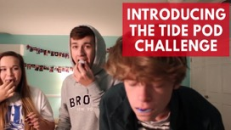
PLS Community Service Challenge
Form a team!
Teams of 2-4, students and faculty allowed
Deadline to sign up is January 31st at 11:59PM
Volunteer and record your hours!
Challenge runs from February 1st-28th
Prizes
1st place: $15 gift cards
2nd place: $10 gift cards
3rd place: $5 gift cards
Top Team of the Week: Secret Special Prize!
Will send out e-mail with signup and more details after the meeting

Slide 8
Save the Date: Rx Factor and Silent Auction
WHAT: Free Admission and Refreshments
Come Participate in the WSPS Silent Auction. Items to be donated by students, staff, and local businesses to benefit the WSPS travel grant!
RX Factor and Talent Show to follow the Silent Auction. Watch some of your fellow student pharmacists share their talents!
Vote in the Mr. Pharmacy Competition. Winner will receive a prize.
WHEN WHERE
April 5th, 2018 Rennebohm Hall
Silent Auction: 12-4:45 PM The Commons
Rx Factor: 5-6:30 PM Room 2002
CONTACT
Looking to participate in the RX factor or Mr. Pharmacy Competition? Want to donate an item for the Silent Auction? Questions?
Email Christine Wacek (cwacek@wisc.edu) or Nicole Haebig (nhaebig@wisc.edu)

Slide 9
Student Senate Update
Notes:
Looking for sober monitors – this is a great opportunity to get points for your team for the PLS Community Service Challenge!!

Slide 10
Mark your Calendars!
Friday, March 2nd
Time TBD

Slide 11
Minute to Win It
https://www.youtube.com/watch?v=jVqyomuqH-s

Slide 12
Midyear Regional Meeting
States within Region 4
Wisconsin
Illinois
Michigan
Ohio
Indiana
Kentucky
23 Schools and 1 Satellite Campus

Slide 13
Where is the next MRM?
Madison WI
When?
Hosted by WSPS
Fall Semester - weekend in October or November

Slide 14
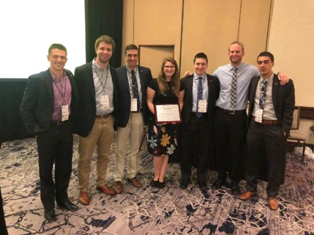
MRM Agenda
What Occurs at MRM?
Friday Night Social
Networking
Programming
Leadership Training Series
APhA-ASP policy proposal forum
Regional Officer Elections

Slide 15
How can I get Involved?
Types of Committees
Join a Committee
Become a Committee Leader
Fundraising
Exhibitors
Decorating
Registration/Gift Bags
Promotion/Advertising

Slide 16
Why should I get Involved?
CV Booster
Ran by Students for Students
Notes:
Talk about how many people went to the career fair wishing they had more on their CV
Making connections with exhibitors

Slide 17
Stay Tuned!
Committee Information Meetings to come in February

