Slide 1
Wisconsin Society of Pharmacy Students
General Meeting
November 7th, 2016
5:00 pm

Slide 2
Agenda
Announcements
Nick Capote, PGY2
Awards!
Dinner!

Slide 3
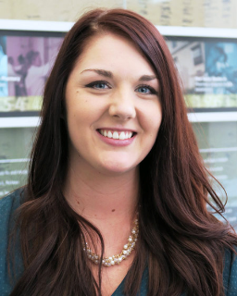
New MEDiC Liaison!
The new MEDiC Council has been finalized…
Congratulations to our new MEDiC Liaison, Kate Berlin!

Slide 4
Updates From Student Senate
Career Fair – Thank you!!
School Wide Food Drive – competition between houses
Leadership
List of positions will be sent out
Colloquium for informal leadership on CV
Rho Chi Private Tutors
School Calendar adjustments – Board of Visitors

Slide 5
Networking Luncheon
WHAT: Luncheon with pharmacists to provide students an opportunity to meet pharmacy professionals from a variety of backgrounds, learn about possible career choices, and practice their networking skills
WHEN: Tuesday November 15, 2016 from 12:00-1:15PM
WHERE: The School of Pharmacy Commons
Cost: $5

Slide 6
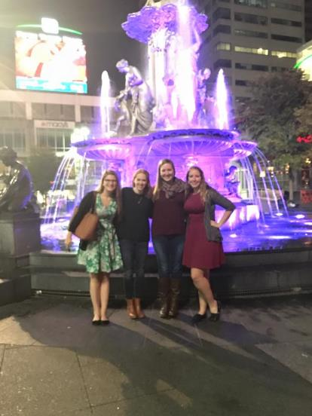
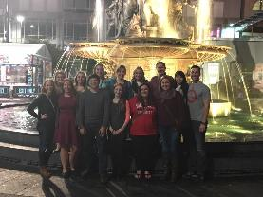
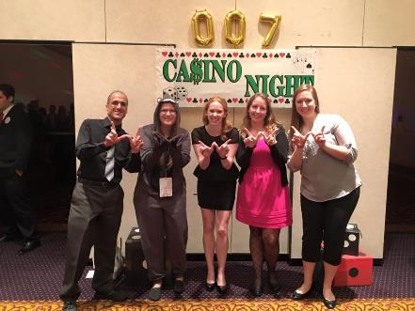
MRM Recap
Notes:
Networked with student pharmacists from 23 other chapters
Attended presentations relating to Generation Rx,,Operation Self Care, Pharmacy Entrepreneurship, Residency Preparedness
Participated in the next step of the policy proposal process

Slide 7
“90 Second Policy Challenge: October 2016”
Provider Status Update:
Background
Current Cosponsor Count: H.R.592 - 293 | S.314 - 51
California’s Medicaid Program to Cover Pharmacists’ Services
Local:
Priority: Medicaid Reimbursement to Pharmacies
National:
S. 3454 Bill Introduced to Improve Medication Adherences
Time Up!

Slide 8
Nick Capote

Slide 9
THE HOLY COW AWARD!

Slide 10
HOLY COW! GREAT JOB!
This DPH-1 member has shown great initiative by taking over the role of Pharmflix director. This member has also been involved in several other events pertaining to WSPS.

Slide 11
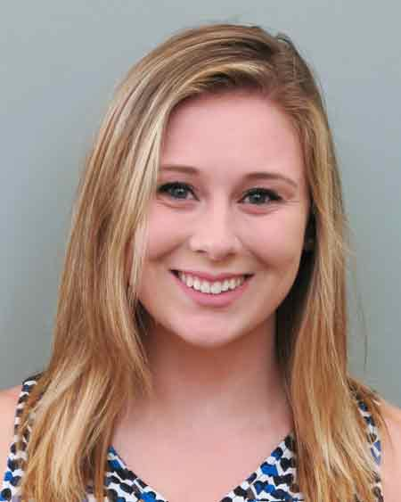
THE HOLY COW AWARD GOES TO…
Miranda Bowers
Great Job Miranda!

Slide 12
REMINDERS
CHANGE IN DATE FOR DECEMBER MEETING!
Monday, December 5th at 5pm Room 2002
Now, PIZZA!!!

