Slide 2
WSPS Meetings and Events
WSPS General Meetings
Wednesday, February 8th at 5:30
Monday, March 6th at 5:30
Thursday, April 6th at 6:30
Thursday, April 27th at 5:45pm
WSPS Events
Health and Wellness Fairs
Rx Factor
White Coat Ceremony

Slide 3
State and National Meetings
March 2nd, 2017 PSW Legislative Day
Madison, WI
March 24th-27th, 2017 APhA Annual
San Francisco, CA
April 6th and 7th, 2017 PSW Educational Conference
Madison, WI
Notes:
Do NOT sign up for things you will not attend.

Slide 4
PAA-WSPS Golf Outing 2017
Friday June 16th 2017 – University Ridge Golf Course
Looking for volunteers to help out with events
Meet pharmacists from around the state while doing this
Volunteers will also get food covered for day – taco bar for dinner!
Last year WSPS was awarded $3000 for our help
Going toward reimbursement of student travel
Also looking for students potentially interested in golfing
More information to come!

Slide 5
WSPS Executive Council Elections
Candidates will each be given 2 minutes to address the membership
Only vote for one candidate per position
Majority vote of members present is required to be elected

Slide 6
WSPS Executive Council Elections
Secretary/Historian
Student Senate Representative
Treasurer-Elect
President-Elect

Slide 7
WSPS Executive Council Elections
Secretary/Historian
Student Senate Representative
Treasurer-Elect
Co-Director of Community Outreach

Slide 8
Candidates for Secretary/Historian
Marnie Janson, DPH-2

Slide 9
Marnie Janson
I am passionate about WSPS because it is the number one pharmacy organization within the school of pharmacy where members can make a difference at the local, state, and national level in the profession of pharmacy and in patient care
As secretary this past year, I advanced our involvement with Alzheimer’s awareness and education through the Walk to End Alzheimer’s and the upcoming bookclub, and I would like to expand our involvement in each next year
I helped organize the suicide prevention training and would like to continue that next year as well
I would like to continue to get more members involved in WSPS through activities, volunteering, and attending conferences

Slide 10
WSPS Executive Council Elections
Secretary/Historian
Student Senate Representative
Treasurer-Elect
Co-Director of Community Outreach

Slide 11
Candidates for Student Senate Rep
Sydney Steiner, DPH-2
Carlie Wilke, DPH-1

Slide 12
Sydney Steiner
WSPS has a large presence in this school and I enjoy keeping the school in the loop with all the great things we are doing as an organization
I’m approachable and I love to get other people involved
I’m a huge advocate for WSPS and the pharmacy profession as a whole
I love working collaboratively with a team, whether it’s composed of peers, faculty or other health care professionals
I like to be a change maker – if there are areas for improvement in the organization, school or profession I encourage people to bring these to my attention so we can work together to make a change.

Slide 13
Carlie Wilke
During undergrad, I served on the Colleges Against Cancer executive board for two years
I have been actively involved in WSPS since becoming a member
Attended all general meetings
Volunteered with OD, ODA, Medic, & MedDrop
Attended PSW Legislative Day & will be attending the APhA Annual Meeting
I will devote my time to being the Student Senate Representative & advocating on your behalf
My goals for this position are to expand membership involvement & improve communication

Slide 14
WSPS Executive Council Elections
Secretary/Historian
Student Senate Representative
Treasurer-Elect
Co-Director of Community Outreach

Slide 15
Candidates for Treasurer-Elect
Bernie Brooks, DPH-1
Greg Norsten, DPH-1

Slide 16
Bernie Brooks
I am…
Passionate about WSPS, its mission, and its vision
Very efficient with budgeting
Currently involved with 5 outreach programs
Not afraid to say “No.”
Decisive, methodical, personable, and serious, yet fun

Slide 17
Greg Norsten
I am passionate about the position of treasurer-elect in WSPS because it is vital to the organization. Through the position I will be able to gain business and leadership experience. As a student pursuing more of a managerial role in a pharmacy, I think this would be a beneficial role for my future. This will help me contribute to this wonderful organization and hopefully make an impact. I am the best candidate for this position because I am passionate about this organization and what is has to offer, responsible and committed to advancing our experience as pharmacy school students.

Slide 18
WSPS Executive Council Elections
Secretary/Historian
Student Senate Representative
Treasurer-Elect
Co-Director of Community Outreach

Slide 19
Candidates for Co-Doc
Beatriz Jimenez Camilla, DPH-2
Allison Martin, DPH-2

Slide 20
Beatriz Jimenez Cadilla
Ever since I joined WSPS organization I have had the opportunity to volunteer in a diverse number of settings. I have participated as a translator for Operation Diabetes, Operation Immunizations and other WSPS activities. These experiences are something I look forward to as a pharmacy student since I have the chance to reach out to the Hispanic Community in Madison. Through the organization, I have established long lasting relationships with Saint Vincent De Paul, Catholic Multicultural Center, Centro Hispano and MEDIC Southside Clinic. I am proud to be a reliable WSPS member and would like to continue building bridges between WSPS, School of Pharmacy and the Hispanic community. There is a large underprivileged Hispanic Community in Madison, with a language barrier, in need of someone to look out for them, these are the people WSPS needs to reach.

Slide 21
Allison Martin
I have seen first hand, the positive effects of the community outreach opportunities created by WSPS, I am excited to help coordinate these opportunities to help a diverse patient population.
I have gained several ideas and valuable insight from speaking with the current Co-Docs, Emily and Kara; the elected Co-Doc, Collin; and current Operation Co-Chairs.
My vision for this position is to help co-chairs and students navigate through the new accreditation requirements as well as continue the great work of Emily and Kara in setting up health fairs.
I plan to create a team between the operations by sharing the great things the operations are doing with one another and by bridging the gap between operations to expand the opportunities for all co-chairs.
I look forward to taking initiative and being an organized team player that can aid in providing new opportunities as well as be a resource for the co-chairs and members of WSPS!

Slide 22
Time to Vote!

Slide 23
Announcements

Slide 24
Rx Factor and Silent Auction
WHAT – FREE Admission and Refreshments
Come participate in the WSPS Silent Auction. Items donated by students, staff and local businesses to benefit the WSPS Conference Travel Fund!
RX Factor Talent Show to follow the Silent Auction. Watch your fellow student pharmacists share their talents!
Vote in the Mr. Pharmacy Competition and the winner will receive a prize!
WHEN
April 19th, 2017 Rennebohm Hall
Silent Auction: 12-4:45 PM The Commons
Rx Factor: 5-6:30 PM Room 2006
CONTACT
Looking to participate in the Rx Factor or Mr. Pharmacy Competition? Want to donate an item for the Silent Auction? Questions?
Email: uwwspsrxfactor@gmail.com

Slide 25
Updates From Student Senate
All School Leadership Position Google Calendar
https://calendar.google.com/calendar/embed?src=uwsopsenate%40gmail.com
* Quality not Quantity
Ice Cream Social:
Tuesday, Mar 14
Senate Fundraiser!!
Where: Buffalo Wild Wings
When: April 17th from 11 am – 12 am (basically all day!)

Slide 26
4th Year Membership Options
1) 2 year APhA dual membership
The APhA Complete Review of Pharmacy, 11th edition
Access to NAPLEX review section of PharmacyLibrary
300 bonus member-only test prep questions
Discounted price with code DDS16 (save $10!)
Professional Liability Insurance
Must sign up prior to April 30th
2) Final APhA-ASP year membership
Same benefits as previous years, including reduced fees for professional conferences
Still have memberships with ASHP and PSW as well!

Slide 27
Reimbursement

Slide 28
WSPS Bookclub
Still Alice by Lisa Genova
A book about a woman with early onset Alzheimer’s
Movie Showing
March 31st 1:20PM
Room 2002
Bookclub Discussion
April 14th 1:20PM
Room 2002

Slide 29
Pharm To Tables Competition
Competition between WI pharmacy schools
Food drive
Traveling trophy!
Last week of March or first week of April
Trying to get winner announced at PSW educational conference

Slide 30
“90 Second Policy Challenge: March 2017”
New Competitor
=
New Statistics

Slide 31
“90 Second Policy Challenge: March 2017”
Federal
Improving Transparency and Accuracy in Medicare Part D Drug Spending Act
Medicaid professional dispensing fee changes going into effect on April 1
Wisconsin
Legislative Day
Intern immunization
Red Tape Review
7 Day emergency refills
Time Up!

Slide 33
THE HOLY COW AWARD!

Slide 34
HOLY COW! GREAT JOB!
This DPH-1 student did a great job at operation self care with OTC literacy. He went out to OTC aisles and talked to patients about over the counter medications and how to safely dose them.

Slide 35
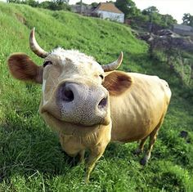
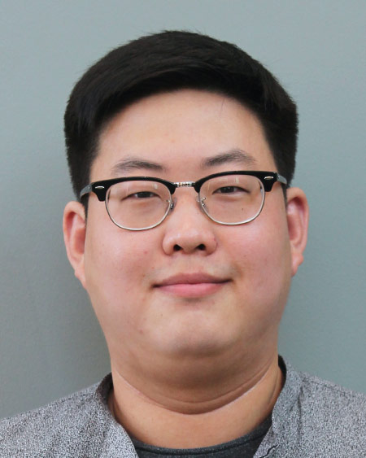
THE HOLY COW AWARD GOES TO…
Jaehyung Choi
Great Job Jaehyung!

Slide 36
WSPS Board Applications
Co-Directors of Community Outreach/President-Elect
1/24-2/6
Executive Council
2/8-3/3
Patient Care Projects
3/6-3/24
Remaining Board Positions
4/6-4/16

Slide 37
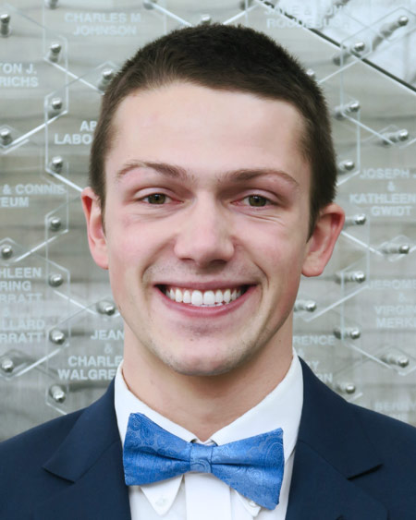
WSPS Transition
Patient Care Positions
March 6th Meeting
Application Open: 3/6 – 3/24
Exec Council
President
Pres-Elect
Secretary
Treasurer-Elect
Co-DoCs
Student Senate Rep
Team Community Outreach
DPH-1 Rep
Operation Heart
Operation Airways
Operation Self-Care
Operation Immunizations
Operation Diabetes
MEDiC
Med Drop
Generation Rx
Personal Health Partners/PSW United Way Liaison
Organ Donation Awareness

Slide 38
WSPS Transition
Remaining Board Positions
April 6th Meeting
Application Open: 4/6 – 4/16
Executive Council Appointment
Exec Council
President
Pres-Elect
Secretary
Treasurer
Co-DoCs
Student Senate Rep
Team Prof Affairs
Team Communications
Team Org Affairs
Team Community Outreach
ASM liason
DPH-1 Rep
Policy liaison(s)
ASHP liaison
APhA liaison
Public Relations
Membership co-chair
Fundraising co-chairs
Professionalism co-chairs

Slide 39
WSPS CO Board Applications
Applications sent via e-mail to WSPS list-serv
Each Community Outreach Co-Chair position will have a SEPARATE application
Make sure you are choosing the right one!
YOU MAY APPLY FOR MORE THAN ONE POSITION
Need a separate application for each position
Voting will be done by the 2016-2017 (current) Executive Council
Order of selecting positions are specified on the applications
Due back to Heather via e-mail by date and time specified

Slide 40
And the winner is…
Secretary/ Historian
Student Senate Representative
Treasurer-elect
Co-Director of Community Outreach
Newly Elected 2016-2017 WSPS Exec Board
Meet at the front of the room for a photo following the meeting!

Slide 41
THANK YOU FOR COMING!
Applications for Patient Care Positions sent out tonight
Don’t forget your food ticket!
NEXT MEETING
WEDNESDAY, APRIL 6TH AT 6:30 PM

Slide 42
Code for Tonight
Make sure you are using the CURRENT Email
1979

