Slide 1
Wisconsin Society of Pharmacy Students
General Meeting
January 24th, 2017
5:30 pm

Slide 2
Agenda
Announcements
Policy Presentation
Guest Speaker: Danielle Laurent, PSW
Adjourn
Board Meet and Greet and Dinner!

Slide 3
Notecards
Write a topic or speaker that you would like to see for our April Meeting!
Examples:
Motivational Speaker
Recovering Addict in our Profession
Resident Panel
Etc.

Slide 4
WSPS Meetings and Events
WSPS General Meetings
Wednesday, February 8th at 5:30
Monday, March 6th at 5:30
Thursday, April 6th at 6:30
Thursday, April 27th at 5:45pm
WSPS Events
Health and Wellness Fairs
Rx Factor
White Coat Ceremony

Slide 5
Board Meet and Greet Tonight!

Slide 6
Resident Meet and Greet
Who: Residents and Students
What: Find your “mentor”
When: Tuesday, January 31st at 7-10pm
Where: Blue Moon
Why: Come find your mentor and meet residents in all different practices of pharmacy in a relaxed setting!

Slide 7
State and National Meetings
March 2nd, 2017 PSW Legislative Day
Madison, WI
March 24th-27th, 2017 APhA Annual
San Francisco, CA
April 6th and 7th, 2017 PSW Educational Conference
Madison, WI
Notes:
Do NOT sign up for things you will not attend.

Slide 8
APhA Annual
March 24th-27th (Friday through Monday)
San Francisco, CA
Registration: $265 (After Feb 1st:$325)
Posters, Presentations, Pharmflix, Phriends, Phood and Phun
Patient Counseling Competition WINNER:
Kelsey Waier
Notes:
Do NOT sign up for things you will not attend.

Slide 9
APhA Annual Reimbursement
Notes:
Do NOT sign up for things you will not attend.

Slide 10
COPs and Training Reminder
Notes:
Do NOT sign up for things you will not attend.

Slide 11
MEDiC Student-Run Free Clinics
February Volunteer Sign-Ups Available!
Regular Shifts & Intern/MTM Shifts
COPs Forms: Please put all MEDiC COPs forms in metal mailbox #18 (labeled “MEDiC”). Forms will be signed and emailed back to you ASAP!
#18
Thanks for volunteering! Questions? Email Kate (kberlin@wisc.edu)

Slide 12
White Coat Ceremony Committees
WHO: DPH-1 students who want to get involved with planning their White Coat Ceremony
WHAT: First committee meeting to learn more about the different committees and pick which one you’d like to be in
WHEN: Wednesday, 1/25/17 1:30-2:30PM (Room TBA)
*This is a great way to get more involved and also looks good on your CV!

Slide 13
PSW Legislative Day
Contact Olivia (ofahey@wisc.edu) or Eric (friestrom@wisc.edu) with questions or for more information
Student registration $35 (WSPS will reimburse $10)
Includes breakfast and lunch
Network with other pharmacists, keep up to date with Wisconsin Pharmacy, and advocate for our profession

Slide 14
“90 Second Policy Challenge: January 2017”
Current Statistics:
0/2 Success
Last Month’s Error: +19s
Average Time: 103s
Average Error: +13s
Standard Deviation: +6s

Slide 15
“90 Second Policy Challenge: January 2017”
Provider Status Update:
Reintroduced to the U.S. Senate January 12th as S. 109
By the end of 2016, the House bill had 296 cosponsors and the Senate companion bill had 51 cosponsors.
Local:
Walker Opioid Abuse Executive Orders
ePDMP Launch! https://pdmp.wi.gov/
Medicaid Covered Outpatient Drug Reimbursement Rule
National:
Potential ACA Repeal/Replace Under New Administration
Time Up!

Slide 16
Danielle Laurent
Notes:
Do NOT sign up for things you will not attend.

Slide 17
WSPS Turnover Overview
Exec Council
President
Pres-Elect
Secretary
Treasurer
Co-DoCs
Student Senate Rep
DPH-1 Rep

Slide 18
WSPS Overview
Exec Council
President
Pres-Elect
Secretary
Treasurer
Co-DoCs
Student Senate Rep
Team Prof Affairs
Team Communications
Team Org Affairs
Team Community Outreach
ASM liason
DPH-1 Rep

Slide 19
WSPS Overview
Exec Council
President
Pres-Elect
Secretary
Treasurer
Co-DoCs
Student Senate Rep
Team Prof Affairs
Team Communications
Team Org Affairs
Team Community Outreach
ASM liason
Policy liaison(s)
ASHP liaison
APhA liaison
Public Relations
Treasurer Elect
Membership
Fundraising Professionalism
OH
OA
OSC
OI
OD
Med Drop
GenRx
ODA
PHP/PSW
MEDiC
DPH-1 Rep

Slide 20
WSPS Transition
Co-Directors of Community Outreach
Exec Council
President
Pres-Elect
Secretary
Treasurer
Co-DoCs
Student Senate Rep
Application Open: TONIGHT 1/24 – 2/6
MUST BE CURRENT CO-CHAIR OF AN OPERATION
Voting at 2/8 General Meeting
DPH-1 Rep
Team Leader = Emily
Operation Heart
Operation Airways
Operation Self-Care
Operation Immunizations
Operation Diabetes
Team Leader = Kara
Personal Health Partners/PSW
Med Drop
Generation Rx
Organ Donation Awareness
MEDiC

Slide 21
WSPS Transition
President-Elect
Exec Council
President
Pres-Elect
Secretary
Treasurer
Student Senate Rep
Co-DoCs
Application Open: TONIGHT 1/24 – 2/6
MUST BE CURRENT DPH-1
Voting at 2/8 General Meeting
DPH-1 Rep

Slide 22
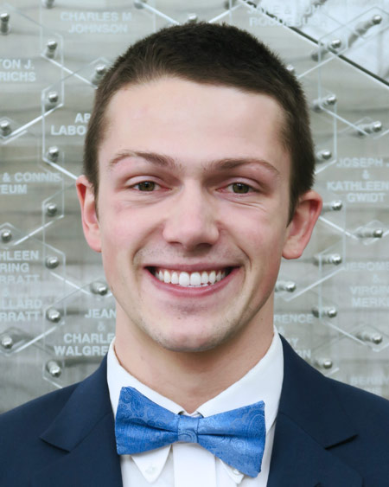
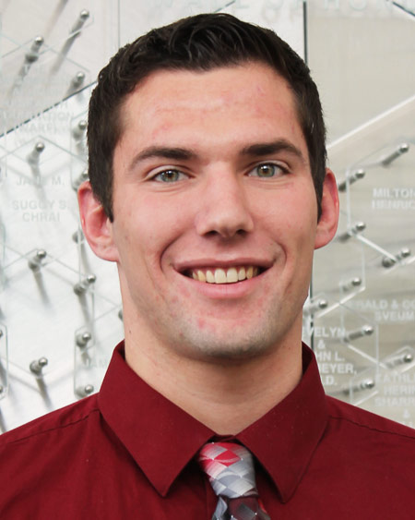
WSPS Transition
Remaining Executive Council
February 8th Meeting
Application Open: 2/8 – 3/3
Voting at 3/6 General Meeting
Exec Council
President
Pres-Elect
Secretary
Co-DoCs
Student Senate Rep
Treasurer
DPH-1 Rep
Treasurer-Elect

Slide 23
WSPS Transition
Patient Care Positions
March 6th Meeting
Application Open: 3/6 – 3/24
Executive Council Appointment
Exec Council
President
Pres-Elect
Secretary
Treasurer-Elect
Co-DoCs
Student Senate Rep
Team Community Outreach
DPH-1 Rep
Operation Heart
Operation Airways
Operation Self-Care
Operation Immunizations
Operation Diabetes
MEDiC
Med Drop
Generation Rx
Personal Health Partners
Organ Donation Awareness
PSW/ United-Way liaison

Slide 24
WSPS Transition
Remaining Board Positions
April 6th Meeting
Application Open: 4/6 – 4/16
Executive Council Appointment
Exec Council
President
Pres-Elect
Secretary
Treasurer
Co-DoCs
Student Senate Rep
Team Prof Affairs
Team Communications
Team Org Affairs
Team Community Outreach
ASM liason
DPH-1 Rep
Policy liaison(s)
ASHP liaison
APhA liaison
Public Relations
Membership co-chair
Fundraising co-chairs
Professionalism co-chairs

Slide 25
WSPS Transition
April 27th Meeting
Appointment of NEW Board!!
Exec Council
President
Pres-Elect
Secretary
Treasurer
Co-DoCs
Student Senate Rep
Team Prof Affairs
Team Communications
Team Org Affairs
Team Community Outreach
ASM liason
DPH-1 Rep

Slide 26
WSPS Board Applications
Co-Directors of Community Outreach/President-Elect
1/24-2/6
Executive Council
2/8-3/3
Patient Care Projects
3/6-3/24
Remaining Board Positions
4/6-4/16

Slide 27
WSPS Meetings and Events
Applications sent via e-mail to WSPS List-serv
Due back to Heather via e-mail by date and time specified
VOTING
General Membership appoints Co-Docs/President-elect
General Membership appoints Exec Council
Exec Council appoints CO
Exec Council appoints remaining positions
Let’s look at a sample application…

Slide 28
Electronic Patient Care Projects Sign-up

Slide 32
Questions?

Slide 33
Thank you for coming!
Look out for the email with the application!
Next Meeting: Wednesday, February 8th at 5:30pm

Slide 34
Access Code for Today
1787

