Slide 1
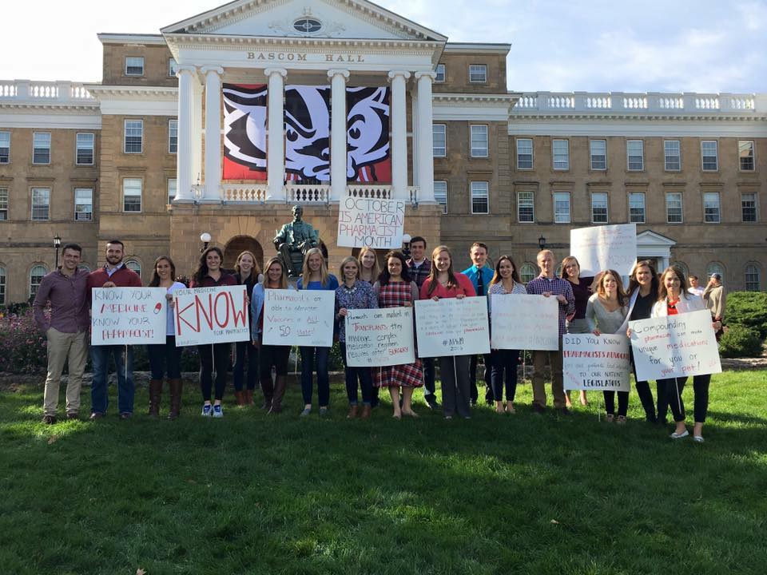
Wisconsin Society of Pharmacy Students
General Meeting
October 10th, 2017
5:30 pm

Slide 2
Agenda
DPH-1 Representative Election
Announcements
Minute to win it
Re-vote (if needed)
Danielle Laurent – PSW Burglary Training
Awards
DPH-1 Representative Announced
Operation Sign-ups
Food!

Slide 3
DPH-1 Representative Elections
Kristin Hesselbach
Emily Jaeger
Clare Procknow
Allie Schrang
Katie Sherman

Slide 4
Kristin Hesselbach
Kristin has a background in research, outpatient pharmacy, and inpatient pharmacy, which is perfect for an organization as diverse as WSPS. Starting a pharmacy journal club, studying the importance of public health, and touring a pharmaceutical research company has also sparked Kristin’s interest in many other areas of the profession. This allows her to relate to and better represent the various interests of her DPH-1 peers. Kristin’s outgoing personality and connections with students from all years of pharmacy school ensures a positive connection between the DPH-1 class and the students of WSPS.

Slide 5
Emily Jaeger
As an undergrad, I was the Panhellenic Delegate for my sorority, thus acting as the liaison between the governing body and my specific chapter. Therefore I have had the experience of attending meetings in which I represented a large number of members and then concisely communicated and implemented changes/policy at the chapter level. I also believe that I have the energy and excitement to represent the new DPH-1 class in WSPS and to plan and procure involvement from my class in events such as Relay for Life. I know the DPH-1 class has a lot to offer this year and I would be honored to be their representative in such a renowned organization!

Slide 6
Clare Procknow
I’ve been very active with UW-Madison’s Relay for Life for the past four years. I was also a peer mentor, so I individually planned events and assisted house fellows. I love to get involved in events and organizations. This is a great opportunity to engage with other first years, as well as collaborate with students from other years.

Slide 7
Allie Schrang
As your representative, I will provide frequent communication to keep you informed about WSPS activities and decisions, and I will always be eager to hear and act upon your ideas. My commitment and enthusiasm for the pharmacy profession will prove to be a valuable asset in this position. Ultimately, my goal is ensure that decisions made by the executive board reflect the voice of the DPH-1 class. I look forward to representing the DPH-1 class and helping us grow as we serve our community!

Slide 8
Katie Sherman
I feel that I am the best candidate for the DPH-1 representative positon because as an out of state student who did not attend UW-Madison for my undergraduate education, I am passionate about getting involved in my new community and establishing a niche for myself in the school and the profession early on. I am organized, approachable, and dependable. I will meet my representative obligations, while also taking the time to stay involved in other realms of WSPS such as the networking committee and Organ Donation Awareness. I am encouraging of and open to everyone’s ideas so that the whole DPH-1 class can feel that they are influential in WSPS.

Slide 9
Let’s Vote!

Slide 10
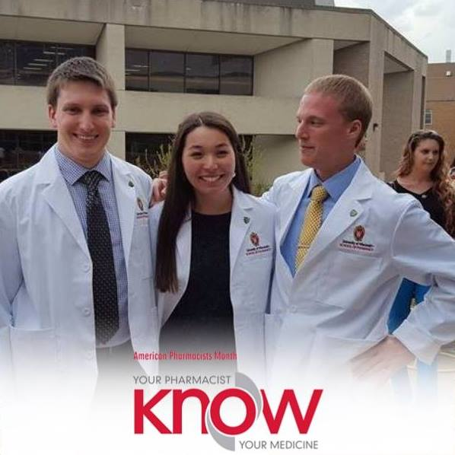
American Pharmacists Month!
Facebook profile frame
Snapchat filter Fridays!
APhM buttons in the SAA office
Bascom Hill Day – Friday October 27th
Sign making party after general meeting in the atrium!
Contact Marnie Janson if you want to get involved!

Slide 12
WSPS Newsletter
Refine your writing skills!
Report on events hosted by WSPS
Provides an update to the SoP
Great opportunity to get to know your fellow classmates!
See email from Hannah Hecht for more information!

Slide 13
Policy Process – APhA-ASP
Resolution – Statement the Academy of Student Pharmacists believes will advance the profession, help student pharmacists and improve patient care
Examples of Past Resolutions
2000.6 - Pharmacists and Student Pharmacists on Medical Teams
APhA-ASP supports and encourages the inclusion of pharmacists and student pharmacists in medical teams and on rounds to optimize patient therapy.
2015.4 – Increased Access to Opioid Reversal Agents
1. APhA-ASP supports state and federal legislation to increase access to opioid reversal agents.
2. APhA-ASP encourages pharmacists and student pharmacists to provide public education about opioid reversal agents, including proper administration in situations of opioid-related drug overdose.

Slide 14
Policy Process – APhA-ASP
Our Proposals to be voted on at MRM (Midyear Regional Meeting)
APhA-ASP supports legislation encouraging the use of technology to ensure proper and safe aseptic parenteral product preparation such as:
Image capture systems
Gravimetric measurement verification
Robotics and closed transfer devices for hazardous product preparation
APhA-ASP supports the development and implementation of specialty pharmacy curriculum at all schools and colleges of pharmacy to promote pharmacist involvement in complex disease state therapy management.

Slide 15
Policy Process – APhA-ASP
Chapter
MRM
Indianapolis this coming weekend
Resolutions Committee
Select the most important resolutions from each region
In January
**Note that MRM will be in Madison next year hosted by Wisconsin chapters

Slide 16
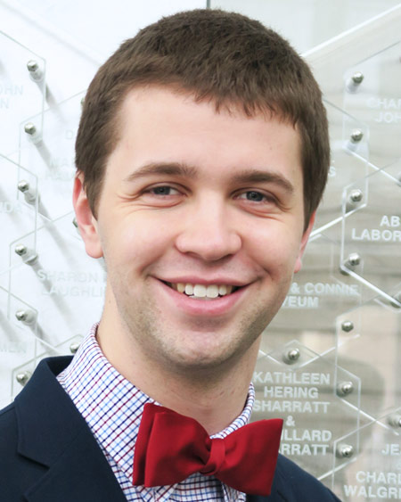
Policy Process – APhA-ASP
APhA-ASP Reference Committee
House of Delegates Votes on Resolutions
Resolution Implemented
Comprised of 137 Chapter Delegates + the 4 National Executive Board members of ASP
WSPS Delegate
(APhA liaison)
Approval By APhA Board of Trustees
Nashville Tennessee

Slide 17
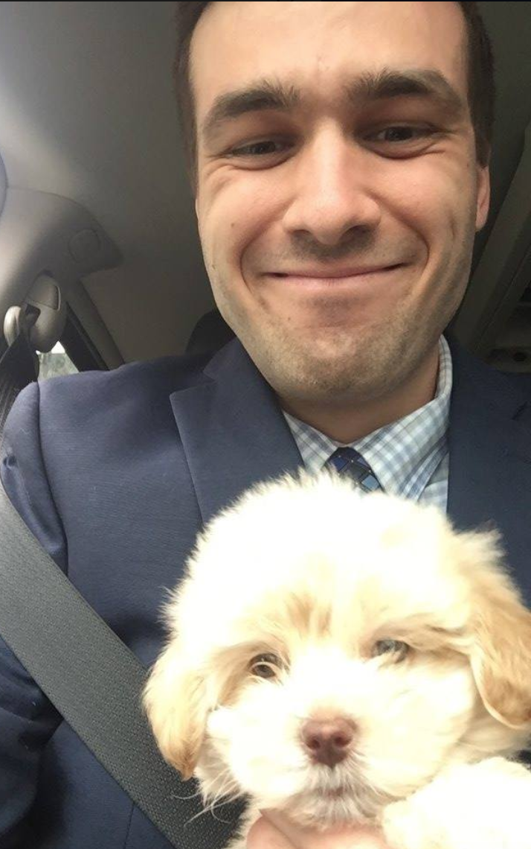
Policy Process – APhA-ASP
How do I get Involved?
Contact Eric Friestrom or Myself
Eric Friestrom <friestrom@wisc.edu>
Drew Dretske <dretske@wisc.edu>
Link for more information
http://www.pharmacist.com/apha-asp-policy-advocacy

Slide 18
Student Senate Update
Addition to Student Voice → Senate Star Student
Recognition of positive things people are doing in the school
$5 Gift cards to nursing school café for Star Student AND nominee
Every two weeks new winners
Class presidents vs Co-Class Presidents
Co-Curricular activity reports
Friday, Oct 27 Bascom Hill American Pharmacist Month
Travel Grants
Career Fair Volunteers
Senate Delegate 11/7 and 12/5

Slide 19
Social Announcement
stiener@wisc.edu

Slide 20
Minute to Win It

Slide 21
Re-vote?

Slide 22
Danielle Laurent

Slide 23
Thank You “Beary” Much Award

Slide 24
Thank You “Beary” Much Award
Member of the Meeting Award
This DPH-1 student is already making her mark on WSPS. She has reached out for opportunities to help out with American Pharmacists Month and is leading the APhM Sign-Making after this meeting!

Slide 25
Thank You “Beary” Much Award
Thanks Clare!
Clare Procknow
DPH-1

Slide 26
DPH-1 Representative Results

Slide 27
Electronic Patient Care Projects Sign-up

Slide 28
WSPS Community Outreach Rules
Please keep this in mind.
You must be trained to volunteer with any Patient Care Project and (if applicable) receive COPs hours
No additional formal trainings will be offered in the fall
Once you place your name on an online sign-up, you cannot remove it – you can swap if you let the co-chairs know
If you remove your name or don’t follow through for an event you signed up for, you will not be able to volunteer with WSPS for the rest of that semester
Legitimate emergencies will not incur this penalty; be sure to communicate with co-chairs if necessary

Slide 32
Questions?

Slide 33
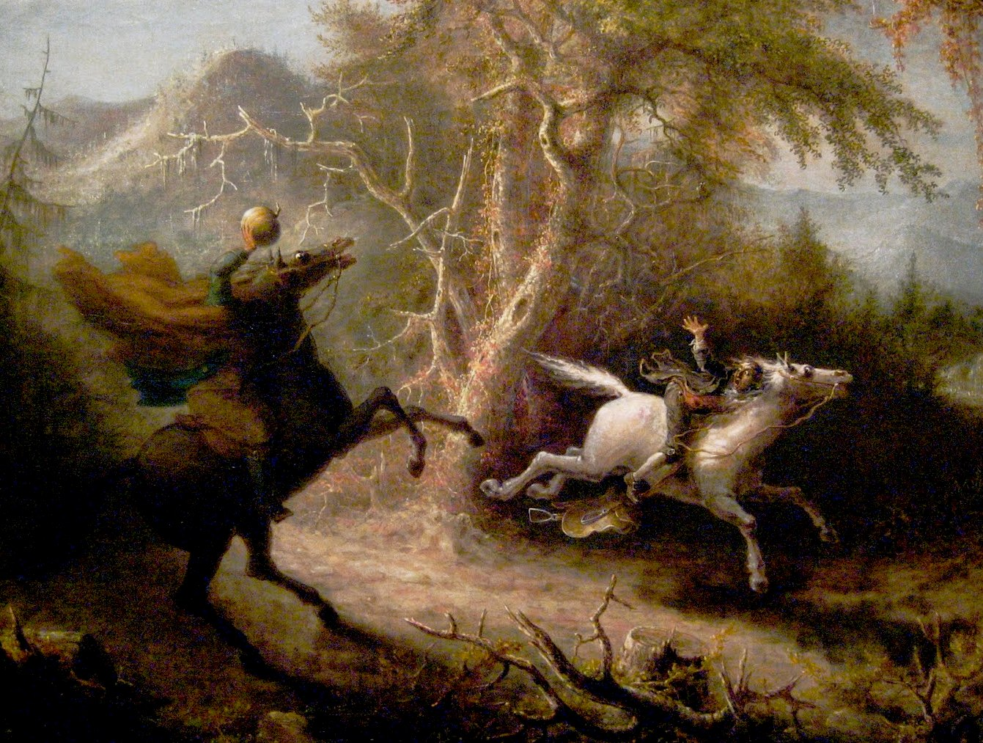
Access Code for Today
Notes:
-Also the year that Charles Darwin set voyage on the HMS Beagle
-First US eye hospital opened
-Maine became the 23rd state

Slide 34
Access Code for Today
1820

Slide 35
Food!
General Reminders:
Board meeting in this room after this meeting – IE I’m kicking you out, sorry
See Karissa if you still need to sign up for WSPS
Don’t forget your tickets!
Next Meeting is Monday, November 6th at 6:30pm!
Thank you for coming!

