Slide 1
Wisconsin Society of Pharmacy Students
General Meeting
September 12th, 2016
5:45 pm

Slide 2
Agenda
Introduction of WSPS Framework
Benefits of APhA, ASHP, PSW, WSPS
Announcements
Board Introduction
Conference Debriefing
Upcoming WSPS Meetings
Dinner!

Slide 3
Attendance and Food Tickets
Try to come to meetings 10-15 minutes early to sign in
Attendance outside of lecture hall at table
You are only allowed to sign in YOUR name
Sign in and receive a ticket
Must present ticket at time of dinner to receive a plate

Slide 4
WSPS Framework and Structure
Exec Council
President
Pres-Elect
Secretary
Treasurer
Co-DoCs
Student Senate Rep
Team Prof Affairs
Team Communications
Team Org Affairs
Team Community Outreach
ASM liason
DPH-1 Rep

Slide 5
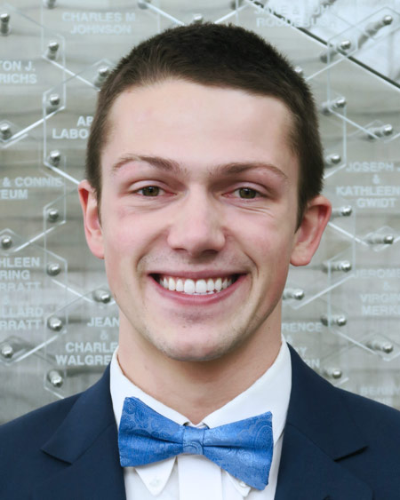
WSPS Team Professional Affairs (PA)
Exec Council
President
Pres-Elect
Secretary
Treasurer
Co-DoCs
Student Senate Rep
Team Prof Affairs
Team Communication
Team Org Affairs
Team Community Outreach
ASM liason
Team Leader = President
President-Elect
Policy liaisons
ASHP liaison
APhA liaison

Slide 6
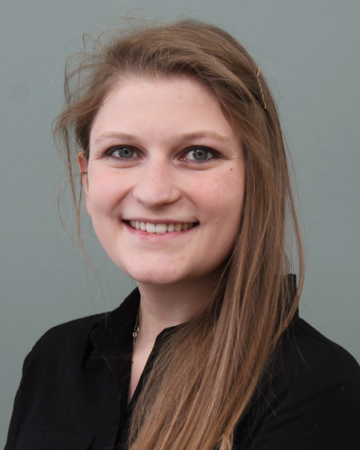
WSPS Team Communications
Exec Council
President
Pres-Elect
Secretary
Treasurer
Co-DoCs
Student Senate Rep
Team Prof Affairs
Team Communications
Team Org Affairs
Team Community Outreach
ASM liason
DPH-1 Rep
Team Leader = Secretary/Historian
Webmaster
DPH-1 rep

Slide 7
DPH-1 Class Representative
Application to come soon via email!
Liaison between WSPS and first year class
Non voting member of the Executive Council
Present awards at each meeting
Update display case out in the atrium
Relay for Life Team Captain
Application due on Monday, October 10th. Speeches and voting at the October 12th meeting!
Questions? Contact Heather (hstoner@wisc.edu) or Connor (cthanson2@wisc.edu)

Slide 8
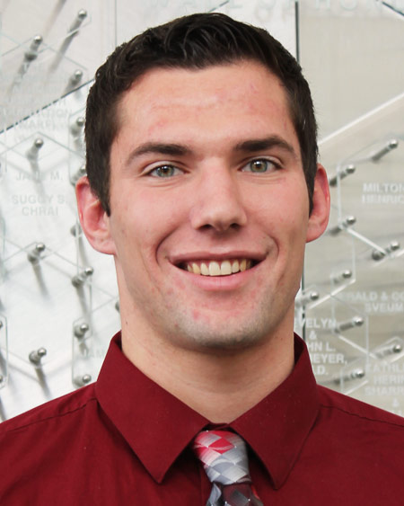
WSPS Team Organizational Fairs
Exec Council
President
Pres-Elect
Secretary
Treasurer
Co-DoCs
Student Senate Rep
Team Prof Affairs
Team Communications
Team Org Affairs
Team Community Outreach
ASM liason
DPH-1 Rep
Team Leader = Treasurer
Treasurer-Elect/ASM Liaison
Membership Chair
Fundraising co-chairs
Professionalism co-chairs

Slide 9
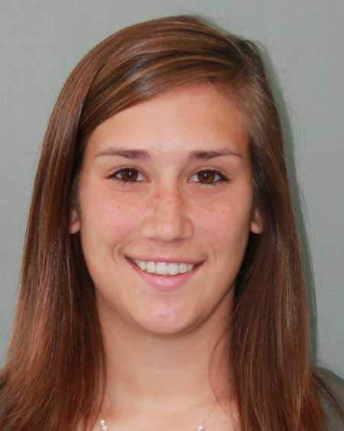
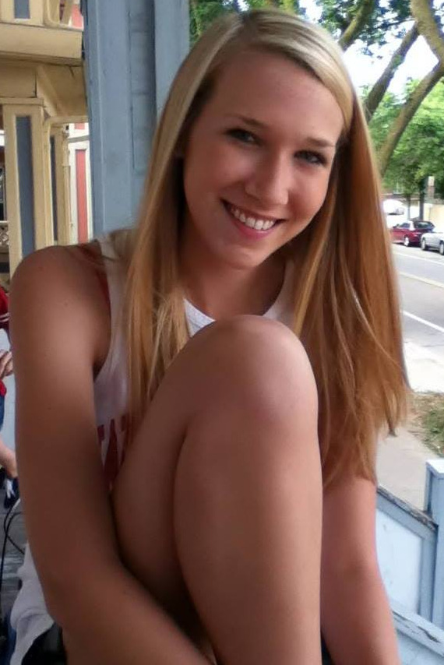
WSPS Community Outreach
Exec Council
President
Pres-Elect
Secretary
Treasurer
Co-DoCs
Student Senate Rep
Team Prof Affairs
Team Communications
Team Org Affairs
Team Community Outreach
ASM liason
DPH-1 Rep
Team Leader = Emily
Operation Heart
Operation Airways
Operation Self-Care
Operation Immunizations
Operation Diabetes
Team Leader = Kara
Med Drop
Generation Rx
Organ Donation Awareness
PHP/ PSW United-Way
MEDiC

Slide 10
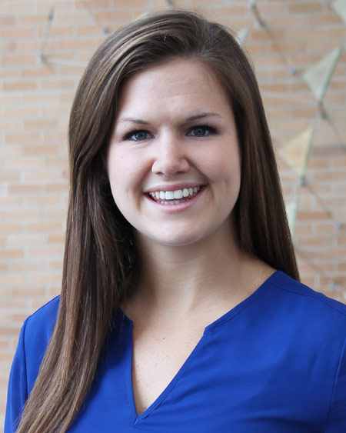
WSPS Student Senate Representative
Exec Council
President
Pres-Elect
Secretary
Treasurer
Co-DoCs
Student Senate Rep
Team Prof Affairs
Team Communications
Team Org Affairs
Team Community Outreach
DPH-1 Rep

Slide 11
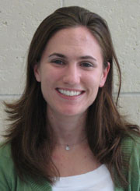
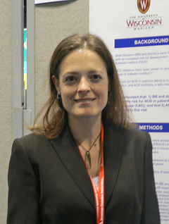
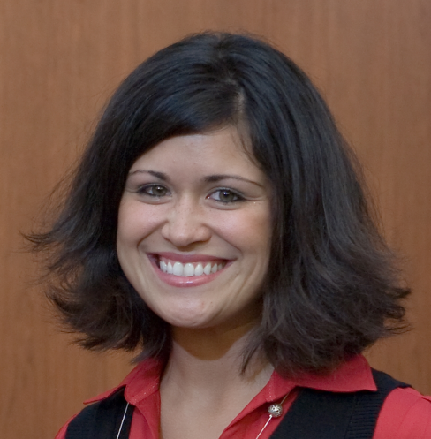
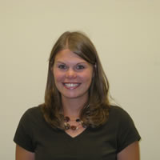
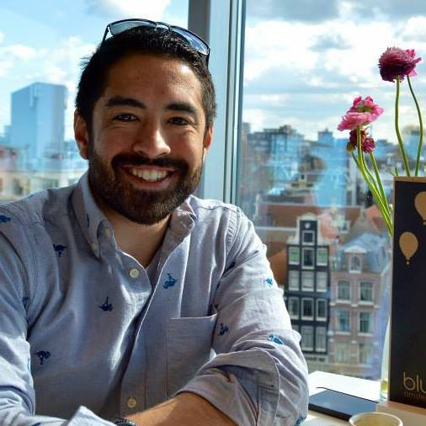
Our WSPS Advisors
Maria Wopat Casey Gallimore Orly Vardeny
Andrea Porter Nick Capote

Slide 12
What can WSPS Give YOU?
PSW
APhA-ASP
ASHP
COPs hours opportunities
Attend national and state-wide conferences
Networking opportunities with pharmacists across the state and country
Leadership opportunities (DPH-1 Rep, Board position)
FUN!
Notes:
connects community pharmacists with patients, physicians, and health plans to improve the quality and reduce the cost of medication use across Wisconsin
Does Medication Therapy Management (MTM) = review medications, communicate with providers if changes are needed, educate patients
-American Pharmacist Association – has Student Pharmacist association (go to MRM) and International Student Federation
-American Society of Health Systems Pharmacists = RESIDENCY

Slide 13
Golf Outing – THANK YOU!
Thank you to Nicole Haebig, Noah Budi, Karissa Fritsch, Olivia Fahey, Christine Garmoe, Collin Dean and Josh Nachreiner for volunteering!

Slide 14
PSW Journal Club 2016-2017
Hone your writing skills!
WSPS Newsletter – highlight our organization
PSW Journal articles
Business member spotlight
Practice changes
Sign-up for more information on sheets!

Slide 15
Updates From Student Senate
Leader of the Month
BABCOCK ICE CREAM!!!
Climate Survey → Leadership positions
Career Fair
Volunteers
Changes

Slide 16
Our WSPS Board
Featuring the very best baby photos out there.
Notes:
Photos not attached due to file size limitation of WSPS web page.

Slide 17
Conferences

Slide 18
PSW Annual

Slide 19
PSW Annual

Slide 20
APhA-ASP MRM
Midyear Regional Meeting
October 28-30, 2016
Cincinnati, OH
Registration $125/member
Hotel $99/night for 4 person room
Only student exclusive conference
Quality educational programming
Exposure to the process of both writing and the approval of policies

Slide 21
ASHP Midyear Clinical Meeting
2016 Meeting- Las Vegas, NV
Mandalay Bay Convention Center
December 4-8th
Theme: Essential Tools for Your Role
Largest gathering of pharmacists in the world (over 20,000 professionals from around the world)
Focus on health systems pharmacy
Keynote speaker for 2016 is Peyton Manning

Slide 22
ASHP Midyear Clinical Meeting
What does it offer for students?
Student programming (student advocacy, leadership, professional development and career focused workshop sessions)
Residency showcase (of particular importance in your fourth year) where students can connect with representatives from residency programs around the country
Clinical Skills Competition for pharmacy students
Student Poster Session
Student’s Night Out- fun with students from around the country

Slide 23
ASHP Midyear Clinical Meeting
What is the cost of attending and the benefits for students?
Student registration: ASHP member cost is $315 (deadline is December 1st)
Cost of flight to Midyear (Las Vegas)
Cost of hotel- reservations can be made through ASHP Midyear site, offer free shuttle to convention center from specified hotel locations
ASM Travel Grant- Reimbursement of around $70 per attendee
In order to minimize costs to you and maximize the benefit you receive from attending the recommendation is to attend your third year to get a feel for the residency showcase and Midyear and then attend fourth year as a prospective resident

Slide 24
PSW Legislative Day
Thursday March 2, 2017
Monona Terrace, Madison
Registration $25/member
Here in Madison=No travel costs!!!
Statewide effort to advocate for approval of pro-pharmacy legislation
Connect with pharmacists across the state to meet with state assembly and senate members
Exposure to the current state of pharmacy policy in Wisconsin and an overview of future pharmacy policy goals

Slide 25
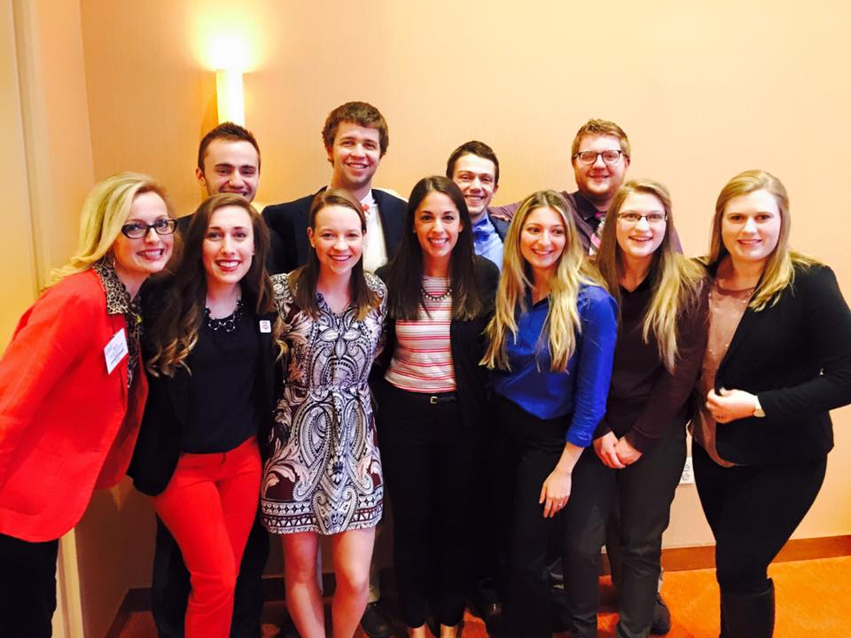
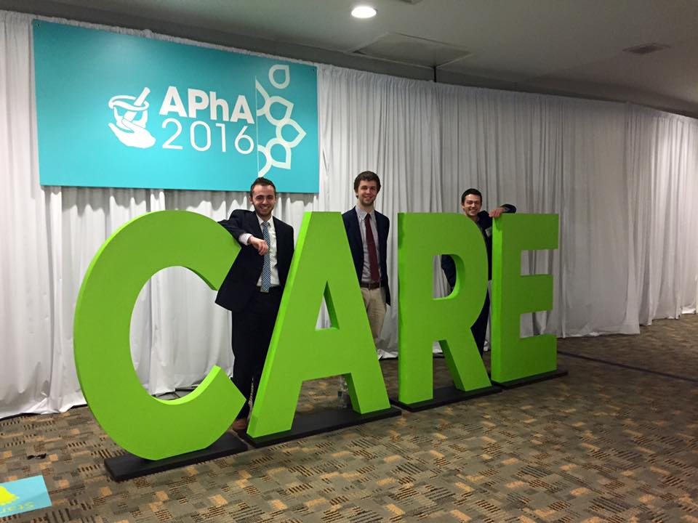
APhA Annual Meeting 2016
Baltimore, MD
10 UW-SOP students attended

Slide 26
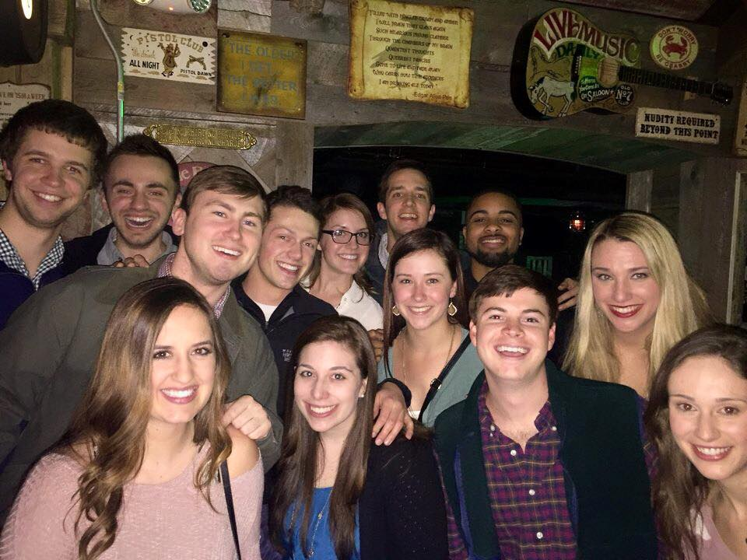
Networking
Because you haven’t heard this word enough

Slide 27
Policy
Make your voice heard on important pharmacy policies

Slide 28
Professional Development

Slide 29
APhA Annual 2017
March 24-27 2017, San Francisco CA

Slide 30
PSW Educational Conference
When: April 6th-7th
Where: Monona Terrace – Madison, WI
Focused for Who: DPH-1 – DPH-4
Meals Included!
Why go?
Takes place in Madison!
Focuses on the updates to pharmacy practice
Provides a small setting to network (smaller than PSW Annual)
Opportunity to attend a poster session to know what projects/research is taking place
Students can present their research!
More information can be found on www.pswi.org

Slide 31
Professionalism at Conferences
Notes:
-dress appropriately
-network
-don’t be shy
-attend the conference
-have fun

Slide 32
Upcoming WSPS General Meetings
Mark these in your planner!
Wednesday, October 12th at 5pm
Monday, November 5th at 5pm
Thursday, December 1st at 5pm
These are also on the pharmacy school’s website calendar!

Slide 33
WSPS Community Outreach Rules
Please keep this in mind.
You must be trained to volunteer with any Patient Care Project and (if applicable) receive COPs hours
No additional formal trainings will be offered in the fall
Advice for DPH-1s: attend as many trainings as possible, you never know who you’ll want to volunteer with in the future
Once you place your name on a physical or online sign-up, you cannot remove it
If you remove your name or don’t follow through for an event you signed up for, you will not be able to volunteer with WSPS for the rest of that semester
Legitimate emergencies will not incur this penalty; be sure to communicate with co-chairs if necessary

Slide 34
COPs Hours Sign-Up
Be nice! No running, pushing, shoving, punching, yelling, etc.
Each Operation will be in a specific part around the room – look for their sign!
Must be trained in that operation to participate in the hours
There are plenty of opportunities for everyone

Slide 35
TIME TO EAT!
General Reminders:
Stick around to sign-up for COPs Hours
Keep a look out in your e-mail about DPH-1 Rep
See Karissa if you still need to sign up for WSPS
Don’t forget your tickets!
Next Meeting is Wednesday, October 12th at 5pm!
Thank you for coming!

