Slide 1

Wisconsin Society of Pharmacy Students
General Meeting
February 8th, 2017
5:30 pm

Slide 2
Agenda
  Announcements
  Executive Board Applications
  Guest Speaker: Nick Olson
  Announce Winners/Revote if needed
  Adjourn

Slide 3
Notecard Results
  Write a topic or speaker that you would like to see for our April Meeting:
  Recovered Addict in our Profession
  Questions that you have!!

Slide 4
WSPS Meetings and Events
  WSPS General Meetings
  Wednesday, February 8th at 5:30
  Monday, March 6th at 5:30
  Thursday, April 6th at 6:30
  Thursday, April 27th at 5:45pm
  WSPS Events
  Health and Wellness Fairs
  Rx Factor
  White Coat Ceremony

Slide 5
State and National Meetings
  March 2nd, 2017 PSW Legislative Day
  Madison, WI
  March 24th-27th, 2017 APhA Annual
  San Francisco, CA
  April 6th and 7th, 2017 PSW Educational Conference
  Madison, WI
Notes:
Do NOT sign up for things you will not attend.

Slide 6
Rx Factor and Silent Auction
WHAT – FREE Admission and Refreshments
Come participate in the WSPS Silent Auction. Items donated by students, staff and local businesses to benefit the WSPS Student Travel Fund!
RX Factor Talent Show to follow the Silent Auction. Watch your fellow student pharmacists share their talents!
Vote in the Mr. Pharmacy Competition and the winner will receive a prize!
  WHEN
  April 19th, 2017 Rennebohm Hall
  Silent Auction: 12-4:45 PM The Commons
  Rx Factor: 5-6:30 PM Room 2006
CONTACT
Looking to participate in the Rx Factor or Mr. Pharmacy Competition? Want to donate an item for the Silent Auction? Questions?
Email: uwwspsrxfactor@gmail.com

Slide 7
PANERA FUNDRAISING NIGHT
  MARCH 1ST from 4 – 8 PM
  PANERA BREAD ON UNIVERSITY
  If 50+ people attend, WSPS will receive 20% of the purchases made that evening!
  MUST bring a copy (paper or electronic) to the event for it to count towards our fundraiser
  INVITE YOUR FRIENDS!!

Slide 8
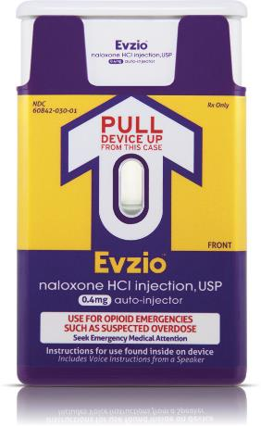
Free Naloxone!
(for you and/or your patients)
Tell a pharmacist you want Naloxone, specifically the Evzio brand (this is the AutoInjector Name Brand Naloxone)
Give the pharmacist your prescription insurance card
The pharmacist will try to run Evzio, but your insurance will more than likely reject the claim (WOOHOO this is actually what we want)
Have the pharmacist call this phone number: (877)-438-9463

Slide 9
Free Naloxone!
(continued)
Smile at the pharmacist or intern while they wait on hold for a few minutes
Once talking to a representative, the pharmacist will explain to the manufacturer that the patient is OVER 18 and commercial insurance is rejecting
The representative will confirm this and then give you a savings card to run through as secondary insurance (Bin, PCN, ID#, person code, & group #)
Prevent some overdoses!

Slide 10

Relay For Life
What: Relay For Life is the signature fundraiser for the American Cancer Society. Relay is a team fundraising event where team members take turns walking around a track or designated path. Each event is 6-24 hours in length and each team is asked to have a member on the track at all times to signify that cancer never sleeps.
When: Friday, April 7th @6 p.m.
Where: CAMP RANDALL SPORTS CENTER
1430 Monroe St. Madison, WI
To donate or join our team: Go to Griffin’s Facebook page or the WSPS Facebook page and click on the link.

Slide 11

PAA-WSPS Golf Outing 2017
  Friday June 16th 2017 – University Ridge Golf Course
  Looking for volunteers to help out with events
    Meet pharmacists from around the state while doing this
    Volunteers will also get food covered for day – taco bar for dinner!
  Last year WSPS was awarded $3000 for our help
    Going toward reimbursement of student travel
  Also looking for students potentially interested in golfing
  More information to come!

Slide 12
Updates From Student Senate
Important Dates:
  Leadership Colloquium – Tuesday, Feb 14
  RAN Ball – Feb 25th
  Ice Cream Social – March 14th
  Badger Bash @ APhA – Saturday, March 25th
  Kremer’s Lecture – April 4th
  Study Day FREEE FOOD – Friday, May 5th
Student Voice – White Boards
Rho Chi Individual Tutors
Legislative Day Buses
Travel Grants
Leadership Considerations

Slide 13

PSW Legislative Day
Contact Olivia (ofahey@wisc.edu) or Eric (friestrom@wisc.edu) with questions or for more information
  Student registration $35 (WSPS will reimburse $10)
    Includes breakfast and lunch
  Network with other pharmacists, keep up to date with Wisconsin Pharmacy, and advocate for our profession

Slide 14

“90 Second Policy Challenge: February 2017”
Current Statistics:
1/3 Success
Last Month’s Error: -3s
Average Time: 98s (Down 4 from last month!)
Average Error: +8s
Standard Deviation: 8.602s

Slide 15
“90 Second Policy Challenge: February 2017”
Provider Status Update:
The Pharmacy and Medically Underserved Areas Enhancement Act (H.R. 592) has been reintroduced in the U.S. House of Representatives
Local:
Legislative Day (3/3)
Community Hour: Legislative Day Prep (2/14)
National:
To Be Determined.
  Executive Order
  Recent News
Time Up!

Slide 16
WSPS Board Applications
  Co-Directors of Community Outreach/President-Elect
    1/24-2/6
  Executive Council
    2/8-3/3
  Patient Care Projects
    3/6-3/24
  Remaining Board Positions
    4/6-4/16

Slide 17



WSPS Transition
Remaining Executive Council
February 8th Meeting
Application Open: 2/8 – 3/3
Voting at 3/6 General Meeting
Exec Council
President
Pres-Elect
Secretary
Co-DoCs
Student Senate Rep
Treasurer
DPH-1 Rep
Treasurer-Elect

Slide 18
WSPS Meetings and Events
  Applications sent via e-mail to WSPS List-serv
  Due back to Heather via e-mail by date and time specified
  VOTING
    General Membership appoints Co-Docs/President-elect
    General Membership appoints Exec Council
    Exec Council appoints CO
    Exec Council appoints remaining positions

Slide 19
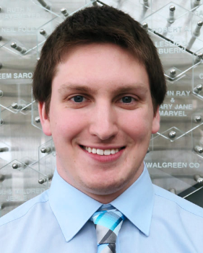
Co-Directors of Community Outreach Elections
Collin Dean

Slide 20
Collin Dean
    My passion for this position stems from my experiences as a DPH-1 within WSPS and has evolved through my position as co-chair of Organ Donation Awareness. By working as a co-chair to extend our group’s outreach to the community, whether it be educating the public or registering potential donors to save and improve recipients’ lives, I have learned much about our capabilities as student pharmacists to make a difference within our society. Having the ability to collaborate with other great organizations to hold events and recruit volunteers has made me proud to represent the profession of pharmacy and this organization. One of my goals to further expand the community outreach position is to create a greater sense of a team-based approach between patients and health care professionals. The primary way I plan to do that is to develop more interprofessional relationships and volunteer opportunities with other health care professionals to benefit the public.

Slide 21
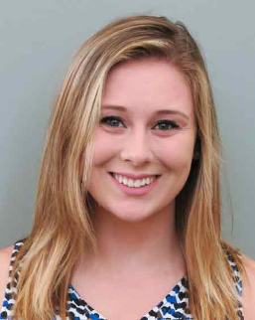
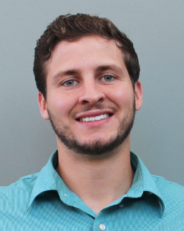
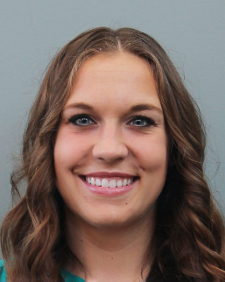
President – Elect Elections
Miranda Bowers
Griffin Budde
Hannah Hecht

Slide 22
Miranda Bowers
I am very organized and have excellent time management skills
Took on role of Director of Pharmflix
Trained in Operation Diabetes/Airways/Heart/Immunizations, Med Drop, MEDiC, and Organ Donation Awareness. Volunteered several times with OD and Med Drop, more to come soon!
Passionate about getting more involved and encouraging others to get more involved both here in Wisconsin and nationally with conference attendance

Slide 23

Griffin Budde
    I believe that my time as DPH-1 rep has shown that I am a driven, friendly and caring individual. If elected to be president elect/president in my third year, I guarantee that we will have the most connected organization this school has ever had. I have a passion for making each student’s future brighter. Building our Badger network strong will lead to successful careers for everyone in the school. Our collective success is my ultimate goal.

Slide 24
Hannah Hecht
This past semester I tried to gain as much exposure to as many different operations and executive positions as possible to see if I could be a good fit as a leader in WSPS, and if I could positively benefit the organization.
After volunteering with Operations Airways, Airways with PHP, and Immunizations, training with Operation Diabetes to volunteer this semester, volunteering at the career fair, being a part of the Coats Committee, and attending the Networking Luncheon I truly believe that I have a good understanding of how WSPS operates and how it could be improved upon.
I have spoken with many general and board members of WSPS and heard many ideas as well as I have many ideas regarding how we can improve our school and our community.
The number and enthusiasm of members of WSPS should inspire us all to realize that we have the power to prompt change in our school and our community, and I would like to help lead that movement.

Slide 25


Slide 26
Nick Olson
Notes:
Do NOT sign up for things you will not attend.

Slide 27
Results
Notes:
Do NOT sign up for things you will not attend.

Slide 28


THE HOLY COW AWARD!

Slide 29

HOLY COW! GREAT JOB!
This DPH-2 translated an entire OD power point into Spanish. She then presented the presentation in Spanish and answered many questions the parents had in Spanish. She put quite a bit of extra time into helping OD reach out to parents who may not have understood the important information had it been presented in English!

Slide 30
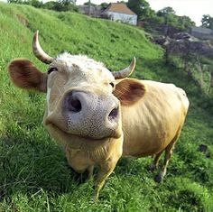
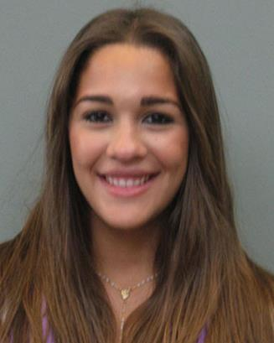
THE HOLY COW AWARD GOES TO…
Beatriz Jimenez Cadilla
Great Job Bea!

Slide 31
Electronic Patient Care Projects Sign-up

Slide 32
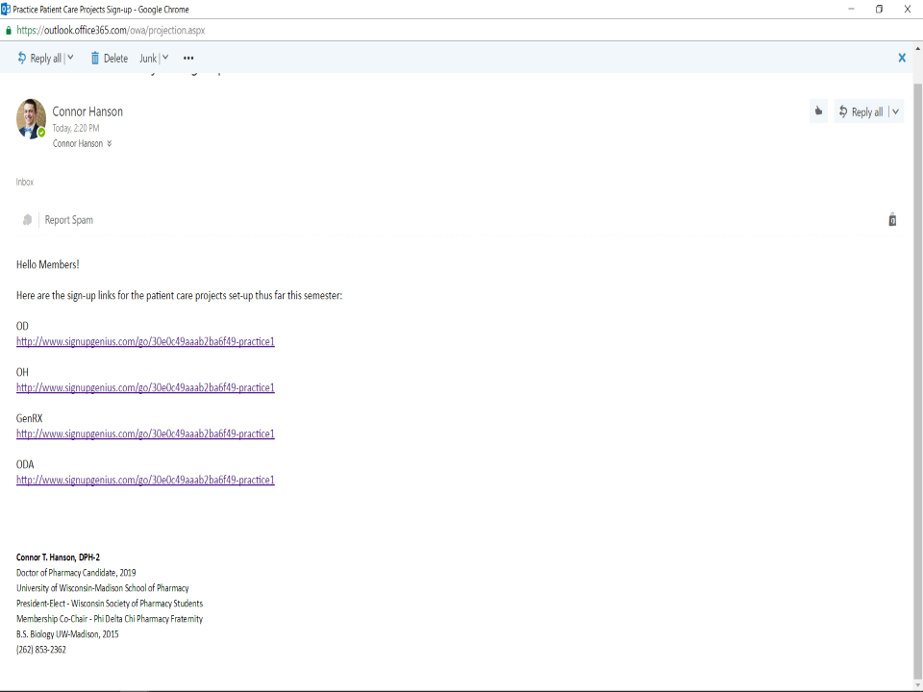

Slide 33
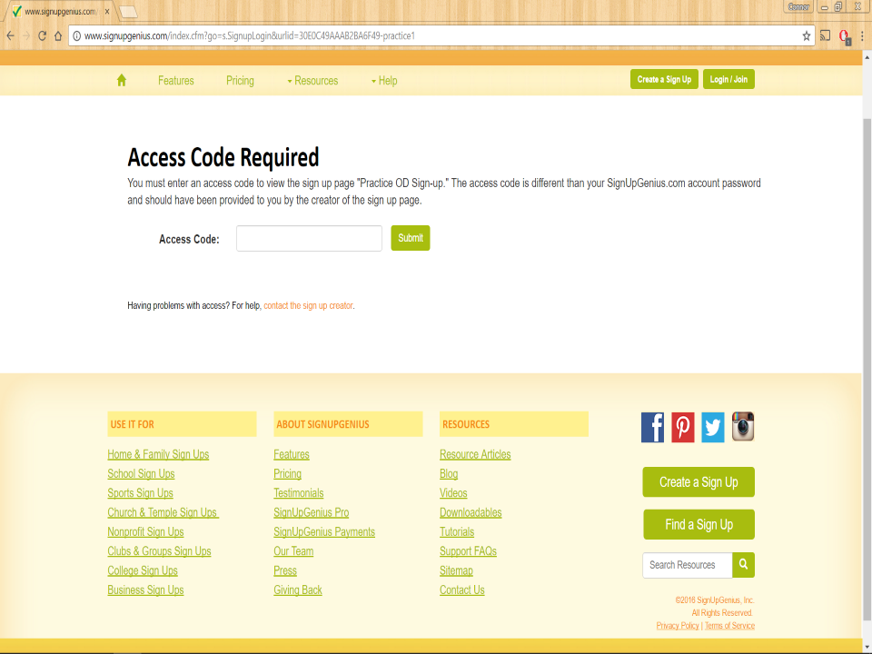

Slide 34
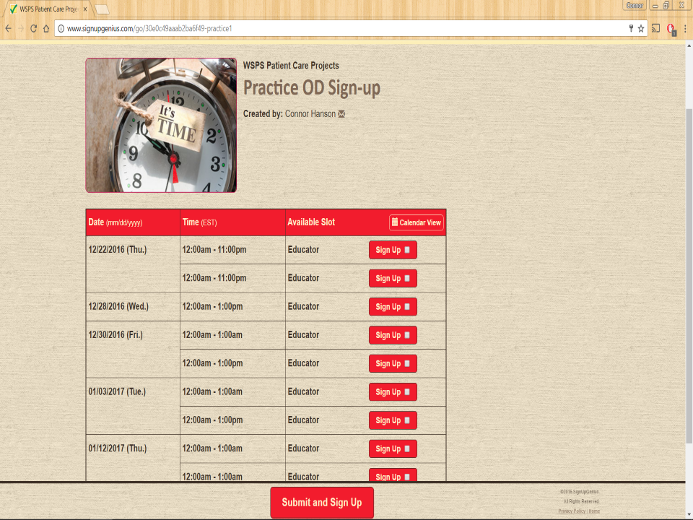

Slide 35
Questions?

Slide 36
Thank you for coming!
  Look out for the email with the application!
  Next Meeting: Monday, March 6th at 5:30pm

Slide 37
Access Code for Today
1215

