Slide 1
Wisconsin Society of Pharmacy Students
General Meeting
December 5th, 2016
5:00 pm

Slide 2
Agenda
Announcements
Pharmflix video premiere
Recognition Awards!
Dinner!

Slide 3
Upcoming Events
Legislative Day
March 2nd, 2017 @ Monona Terrace
APhA Annual
March 24-27,2017 in San Francisco!
Conference tab on Website!

Slide 4
Elections!
Start thinking about if you would like to run for a position!
President-Elect and Co-Docs will be elected at our February Meeting.
Feel free to reach out to anyone on the board!

Slide 5
Update on Semester Stats

Slide 6
Updates From Student Senate
Thank you!!
Update on the Restructuring of the School Calendar
Link to the survey: https://docs.google.com/a/wisc.edu/forms/d/15VJ3UN1s4CILWpSIrIkEAzFEBQ_8cm3fl5MRQI2qZ4c/edit

Slide 7
Policy Related Presentations
This month:
TONIGHT: “Pharmacist Involvement in the Opioid Epidemic”
Kate Hartkopf, Pharm. D, UW-Health
Room 2006 6:15 PM
Future Meetings:
ACPA Naloxone Lecture Series
Legislative Day: March 2nd 2017

Slide 8
“90 Second Policy Challenge: November 2016”
Current Statistics:
0/1 Success
Last Month’s Error: +7s
Average Time: 97s
Average Error: +7s
Standard Deviation: N/A

Slide 9
“90 Second Policy Challenge: November 2016”
Provider Status Update:
Negative: Losing around 40 co-sponsors
Positive: Keeping 259 of the 294 co-sponsors of H.R. 592 and 45 of the current 51 co-sponsors of S. 314
Local:
Controlled Substances Board Report
Enhanced Prescription Drug Monitoring Program (ePDMP) Rollout and New Regulations
National:
21st Century act
“Virginia declares opioid emergency”
“Arizona starts limiting Opioid Prescribing”
“Heroin antidote to be sold without prescription in Iowa”
Time Up!

Slide 10
Pharmflix Video Premiere!

Slide 11
Awards!

Slide 12
THE HOLY COW AWARD!

Slide 13
HOLY COW! GREAT JOB!
This DPH-1 member has volunteered with multiple OA events and has gone above her COPs hour requirement!

Slide 14
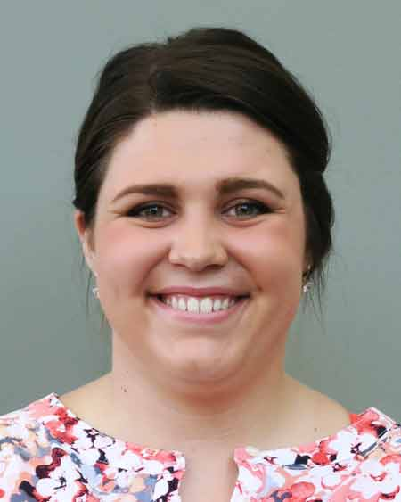
THE HOLY COW AWARD GOES TO…
Elyse Keating
Great Job Elyse!

Slide 15
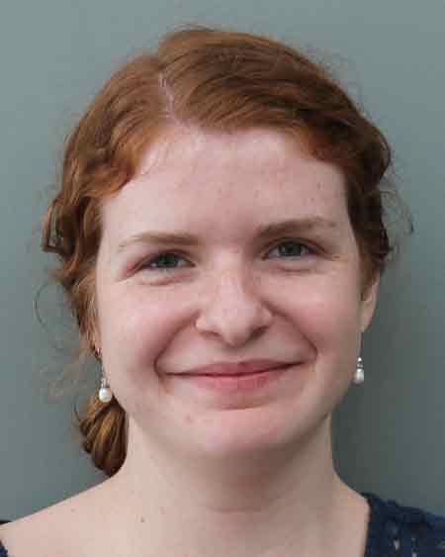
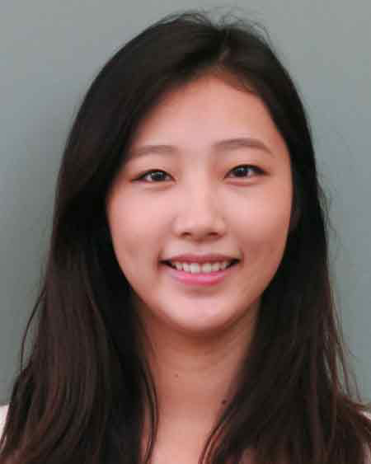
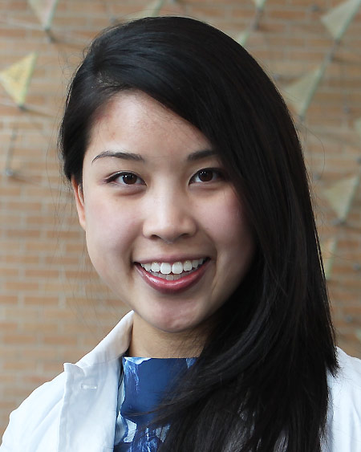
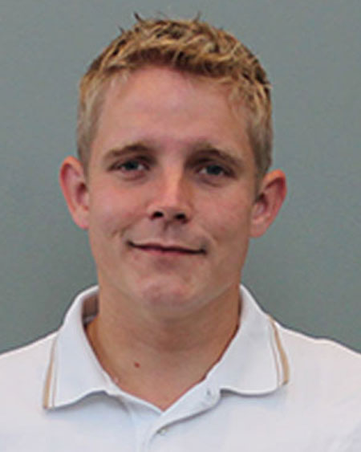
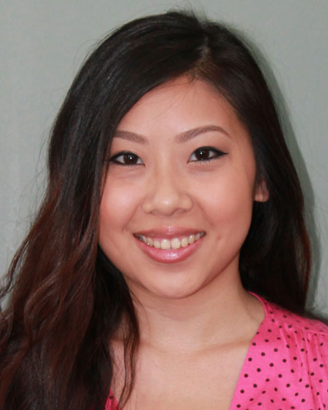
Honorable Mentions
Da Som Kim
DPH-1
Zach Stueber
DPH-2
Lauren O’Dell, Christina Tran, Crystal Vue
DPH-3
Notes:
Da Som – Edited the whole pharmflix video
Zach Stoiberg – ODA volunteer was both dottie and dottie’s escort

Slide 16
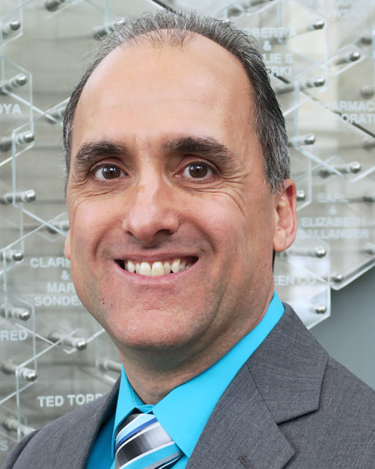
Member of the Semester
This second year student went above and beyond by volunteering for a lot of events and attended MRM in Cincinnati this year!
John Rutsch
DPH-2
Notes:
Da Som – Edited the whole pharmflix video
Zach Stoiberg – ODA volunteer was both dottie and dottie’s escort

Slide 17
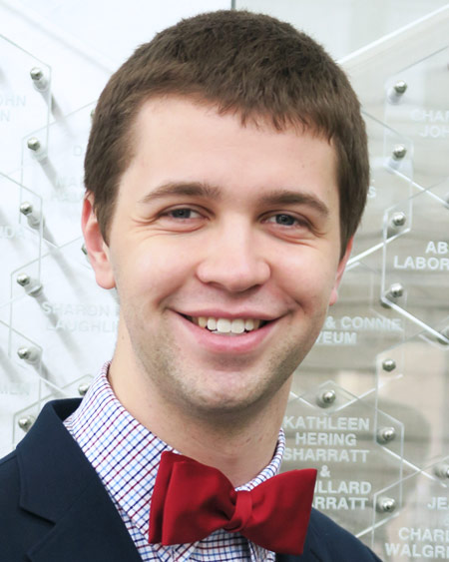
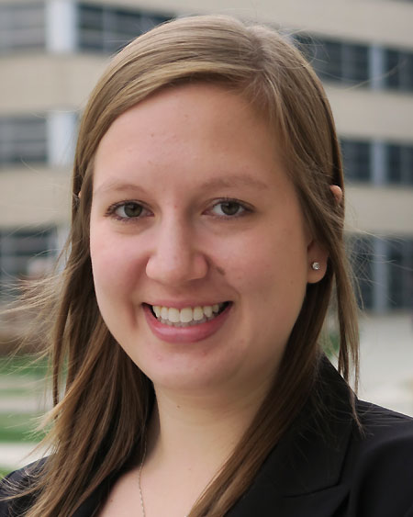
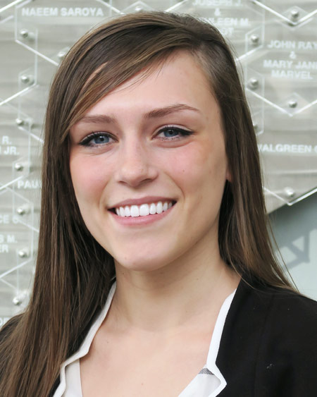
Board Member Shout Outs!
Zach Pedretti
DPH-2
Brooke Geiger
DPH-3
Alanna Benaszeski
DPH-2
Notes:
Zach Pedretti
Brooke Geiger
Alanna

Slide 18
Thanks for coming!
Good luck on finals!!!
Notes:
Da Som – Edited the whole pharmflix video
Zach Stoiberg – ODA volunteer was both dottie and dottie’s escort

