Slide 2
Agenda
Announcements
Guest Speaker: Tracy Head
Final Board Application Announcements
Holy Cow Award
APhA Annual Recap
Sign Up Code
Adjourn

Slide 3
WSPS Meetings and Events
WSPS General Meetings
Wednesday, February 8th at 5:30
Monday, March 6th at 5:30
Thursday, April 6th at 6:30
Thursday, April 27th at 5:45pm
WSPS Events
Health and Wellness Fairs
Rx Factor
White Coat Ceremony

Slide 4
State and National Meetings
March 2nd, 2017 PSW Legislative Day
Madison, WI
March 24th-27th, 2017 APhA Annual
San Francisco, CA
April 6th and 7th, 2017 PSW Educational Conference
Madison, WI
Notes:
Do NOT sign up for things you will not attend.

Slide 5
Announcements

Slide 6
PAA-WSPS Golf Outing 2017
Friday June 16th 2017 – University Ridge Golf Course
Looking for volunteers to help out with events
Meet pharmacists from around the state while doing this
Volunteers will also get food covered for day – taco bar for dinner!
Last year WSPS was awarded $3000 for our help
Going toward reimbursement of student travel
Also looking for students potentially interested in golfing
More information to come!

Slide 7
RX Factor: Wed, 4/19 @ 5 PM
Spelling Bee
Come show off your talents by spelling challenging drug names
Mr. Pharmacy Competition
Formal Wear/Runway Walk
Lip-Synching
Q&A Session
Vote!

Slide 8
Silent Auction: Wed, 4/19 @ 12 PM
LOTS OF EXCITING ITEMS HAVE BEEN DONATED!
Tickets to a Badgers Women’s Volleyball home game of your choice!
Packers Tailgate Party with Drs. Martin and Porter!
Tickets to “Burgers and Brew”!
10-class pass to Dragonfly Yoga!
AND MORE!!!

Slide 9
4th Year Membership Options
1) 2 year APhA dual membership
Save money- 24 months for only $110 with code DDS17
FREE!! The APhA Complete Review of Pharmacy, 11th edition
Members only NAPLEX Review Study Guide
200 Top Drugs list and Pharmacy Mnemonics with Illustrations
Access to NAPLEX review section of PharmacyLibrary
300 bonus member-only test prep questions
Professional Liability Insurance
Must sign up prior to April 30th
2) Final APhA-ASP year membership
Same benefits as previous years, including reduced fees for professional conferences
Still have memberships with ASHP and PSW as well!

Slide 10
Reimbursement/ Student Senate Update

Slide 11
WSPS Bookclub
Spring and Summer volunteer opportunities are available. If interested, contact Sara Neumann at sneumann@alz.org
Still Alice by Lisa Genova
A book about a woman with early onset Alzheimer’s
Movie Showing
March 31st 1:20PM
Room 2002
Bookclub Discussion
April 14th 1:20PM
Room 2002

Slide 12
“90 Second Policy Challenge: April 2017”
Current Statistics:
2/4 Success=50%
Last Trial’s Error: -2s
Average Time: 95.5s (Down 2.5 from last month!)
Average Error: +5.5s
Standard Deviation: 6.574s

Slide 13
“90 Second Policy Challenge: April 2017”
Federal
“Repeal & Replace” Status
AHCA
Wisconsin
New PDMP Reporting Requirements
Changes to Billing and Reimbursement for Covered Outpatient Drugs
Legislative Day Thoughts
Time Up!

Slide 14
Pharm To Tables Competition
Competition between WI pharmacy schools
Food drive: NOW through next Wednesday
Bettering Wisconsin Communities
Traveling trophy!
Trophy on display at the educational conference

Slide 15
Tracy Head

Slide 16
WSPS Board Applications
Co-Directors of Community Outreach/President-Elect
1/24-2/6
Executive Council
2/8-3/3
Patient Care Projects
3/6-3/24
Remaining Board Positions
4/6-4/16

Slide 17
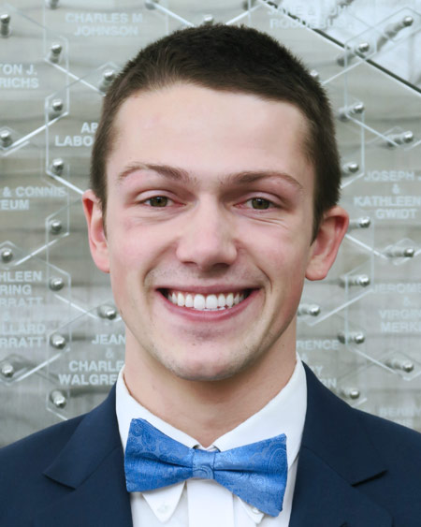
WSPS Transition
Remaining Board Positions
April 6th Meeting
Application Open: 4/6 – 4/16
Executive Council Appointment
Exec Council
President
Pres-Elect
Secretary
Treasurer
Co-DoCs
Student Senate Rep
Team Prof Affairs
Team Communications
Team Org Affairs
Team Community Outreach
Treasurer Elect
DPH-1 Rep
Policy liaison(s)
ASHP liaison
APhA liaison
Public Relations
Membership co-chair
Fundraising co-chairs
Professionalism co-chairs

Slide 18
WSPS Transition
April 27th Meeting
Appointment of NEW Board!!
Exec Council
President
Pres-Elect
Secretary
Treasurer
Co-DoCs
Student Senate Rep
Team Prof Affairs
Team Communications
Team Org Affairs
Team Community Outreach
ASM liason
DPH-1 Rep

Slide 19
WSPS Remaining Board Applications
Applications sent via e-mail to WSPS list-serv
YOU MAY APPLY FOR MORE THAN ONE POSITION
Ranking will be done on application
Must provide rationale for each position ranked
Voting will be done by the 2016-2017 (current) Executive Council
Due back to Heather via e-mail by date and time specified
REMINDER: please put time and effort into applications and talk to the current co-chair liaisons that hold the position!

Slide 21
THE HOLY COW AWARD!

Slide 22
HOLY COW! GREAT JOB!
This DPH-1 student has been incredibly involved with WSPS the entire year. They also took pictures for WSPS at the Wisconsin reception. The pictures were great!

Slide 23
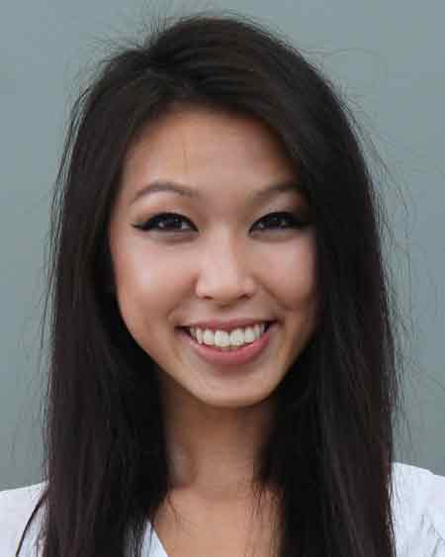
THE HOLY COW AWARD GOES TO…
Angie Ngo
Great Job Angie!

Slide 24
APhA Annual
Movie Time!
Trailer about APhA
https://youtu.be/lGoKwXDKOC4

Slide 25
THANK YOU FOR COMING!
Applications for Remaining Positions sent out tonight
Don’t forget your food ticket!
NEXT MEETING
Thursday, APRIL 27TH AT 5:45 PM

Slide 26
Code for Tonight
Make sure you are using the CURRENT Email
1634

