Slide 1
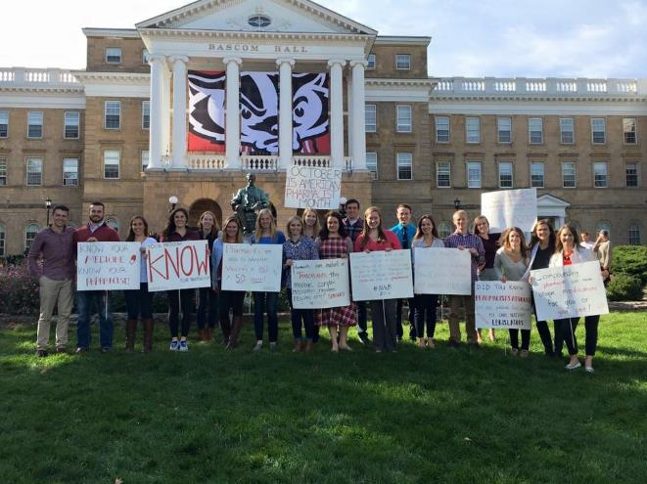
Wisconsin Society of Pharmacy Students
General Meeting
November 6th, 2017
6:30 pm

Slide 2
Agenda
Food!
Announcements
Policy Challenge & Update
APhA Annual Information
Student Senate Update & Minute to Win it
Useful Tools/Resources Presentation
Operation Sign-ups
Go Packers

Slide 3
Distinguished Member Certificate Card
Opportunity to get more involved in WSPS and obtain a certificate!
Criteria (complete by May 2018)
Attend all remaining general meetings
Excuses with justification possible
Participate with 3 operations
Attend a national or local meeting
APhA Annual, ASHP Midyear, PSW Legislative Day, PSW Educational Conference, PSW Annual
Volunteer at or attend 2 events beyond COPs requirements
Attend/participate in 1 miscellaneous event

Slide 4
Congratulations GenerationRx!
At MRM 2017, our chapter’s GenerationRx was chosen as the region’s best for the 2016-2017 academic year.
Congratulations and thank you to Matt Huppert and Kinsey Clark for your hard work last year!

Slide 5
WSPS Newsletter
Refine your writing skills!
Reports on events hosted by WSPS and provides an update to the SoP
Great opportunity to get to know your fellow classmates and co-chairs if you are thinking about a leadership position in WSPS
Preference for article selection for the 2018-2019 Journal Club will be given to those who write for the Newsletter
Opportunities to write an article are still available!
Sign-up link: https://docs.google.com/a/wisc.edu/spreadsheets/d/1LF89nYlspf4q993rwdHN6Hf2hkJVXFBOkTo7uCYKaXI/edit?usp=sharing

Slide 6
MedDrop Project Committee
Looking for 2-3 volunteers to be part of the
MedDrop Project Committee
Work with other students to create a fun, interactive project or game that would help to increase engagement of people at health fairs
Great way to differentiate yourself and show you’re committed to MedDrop and WSPS beyond just COPs hours!
Are you interested?
Email memcconnell@wisc.edu AND swagman3@wisc.edu by November 12th sharing why you want to be part of the committee and any project ideas you might have!

Slide 7
ASHP Updates
October/November News
P&T Committee Meeting sign ups
Midyear Dec 3-7th- If you are attending and have not let me know please do so ASAP
Student Leadership Award through ASHP- Jan 30th 2018
Authors for ASJP Student Column- questions/inquiries students@ashp.org

Slide 8
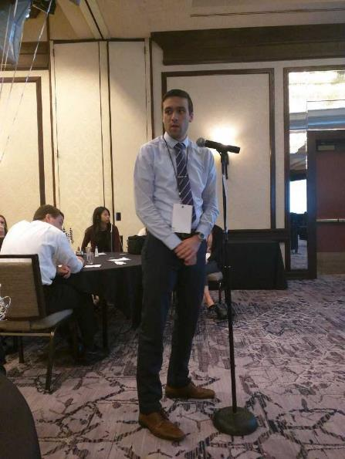
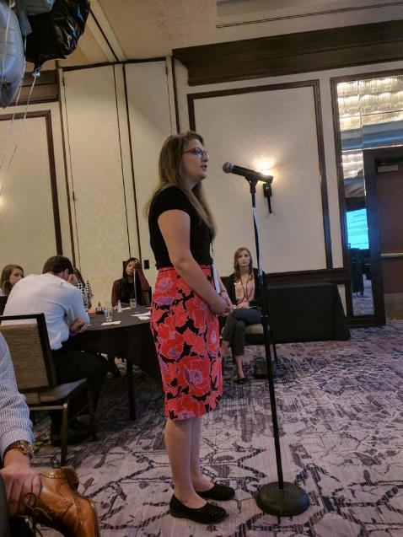
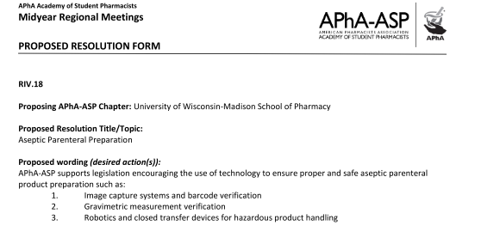

Slide 9
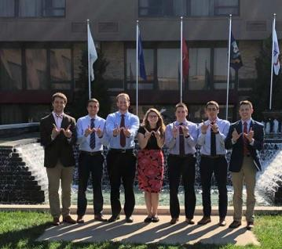
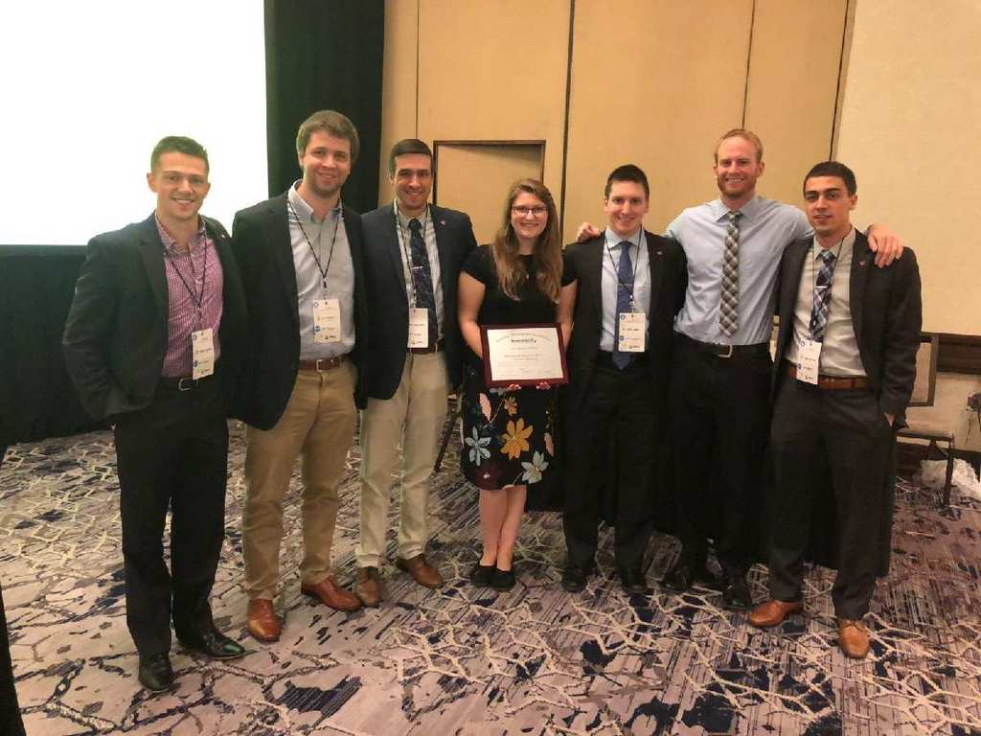

Slide 10
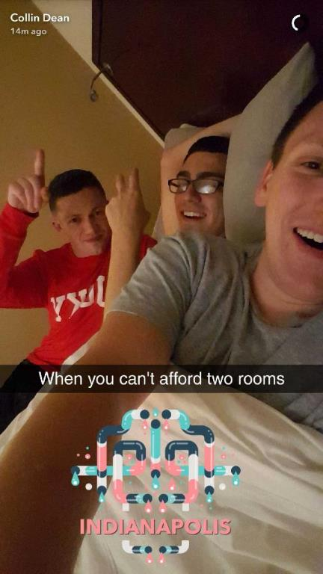
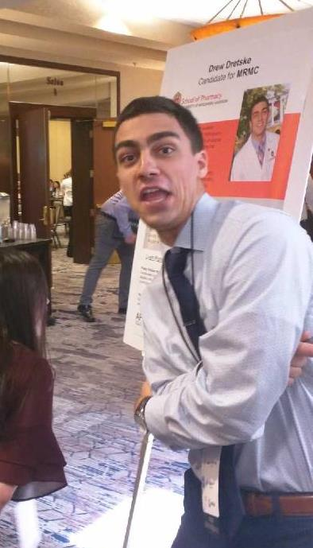
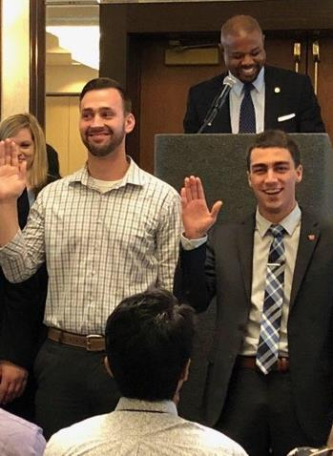

Slide 11
“90 Second Policy Challenge: November 2017”
Spring 2017 Statistics:
2/6 Success=33%
Last Trial’s Error: -13s
Average Time: 106.8s Average Error: +16.8s
Standard Deviation: 12.344s

Slide 12
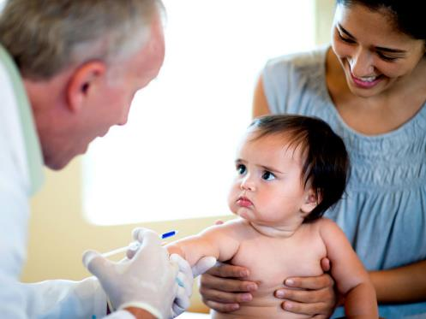
“90 Second Policy Challenge: November 2017”
State:
Immunization Expansion
Federal:
Provider Status
45 Seconds Up
Time Up!

Slide 13
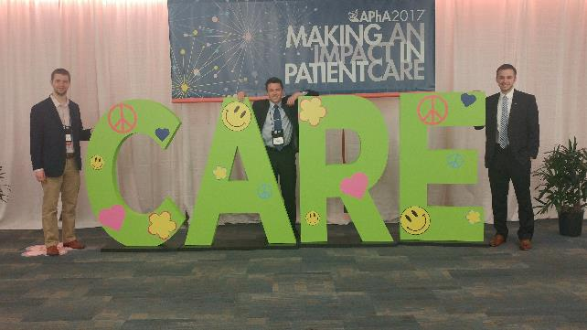
APhA Annual 2018
March 16th – 19th 2018 in Nashville, TN
Registration is OPEN
Registration is ~$325
Will reimburse as much as possible (dependent on finances)
Cheap Hotels
Currently can get hotel rooms for $122.50/night
Westin Nashville
Access through APhA Annual page
http://aphameeting.pharmacist.com/
Hotel reservations → Online Hotel Reservations with Interactive Map

Slide 14
Student Senate Update
Notes:
Carrer fair volunteers → feel free to talk to me about any feedback you have regarding your job as a volunteer – they love this feedback!
Rachel Kent → volunteered to represent WSPS tomorrow at our meeting because I will be taking an exam

Slide 15
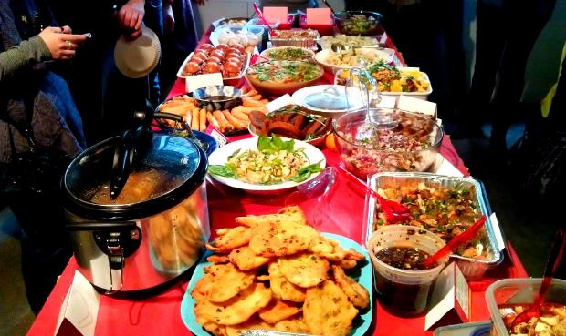
Social Announcement
Late Night Ice Skating
Thursdays 11:15 pm -12:45 am ***
Monday-Wednesday 6:15 pm - 7:15 pm
Board Game Night Pot Luck

Slide 16
Minute to Win It
https://www.youtube.com/watch?v=od6KoCYr4nw&index=12&list=PLj-mt9qNAeRVfiHH9i8tOiBhUXvEtp5MI

Slide 17
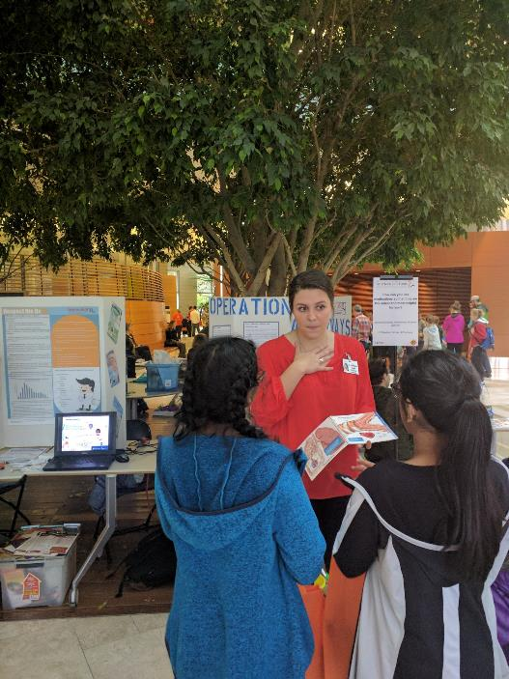
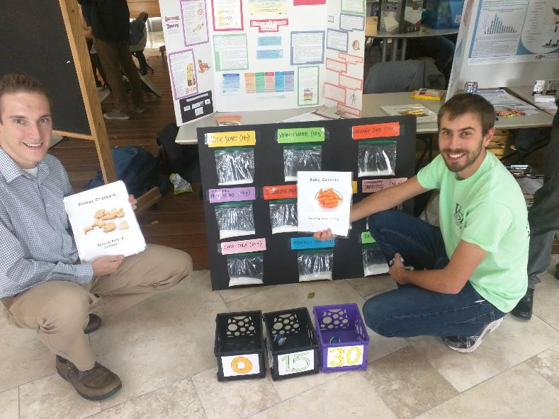
Awesome & Free Resources!

Slide 18
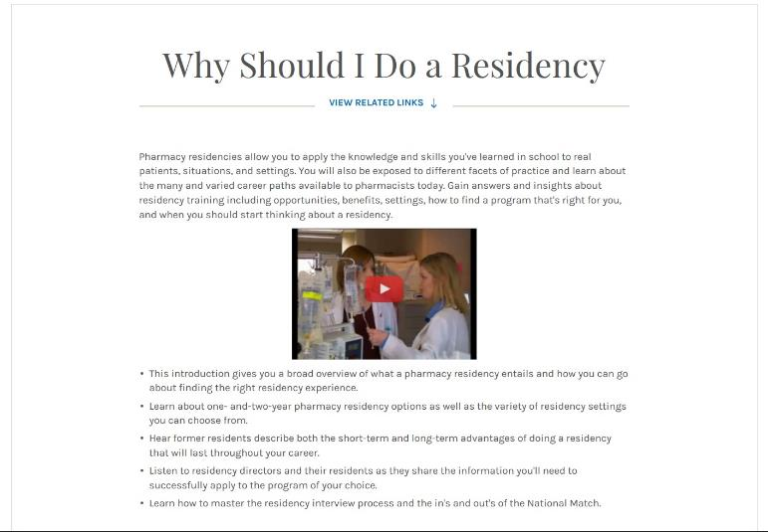
Student Residency Guide
The perfect written guide for all of your residency questions!
https://www.ashp.org/Professional-Development/Residency-Information/Student-Residency-Guide
Notes:
Connor
Sections like:
-Selecting a Residency
-Interview skills packet
-Residency matching program

Slide 19
Residency in Wisconsin
Comprehensive document containing:
All residencies in the state of Wisconsin
What type of residencies are available
Special features of the residency that differentiate it
Person to contact
How many spots are available at each site
Benefits with each residency
http://www.pswi.org/Portals/17/Documents/Resources/Residency%20Book%202017-18.pdf?ver=2016-12-06-122318-057
Notes:
Greg

Slide 20
APhA Career Option Profiles
More than just dispensing medications!
http://www.pharmacist.com/career-option-profiles
Excellent resource to learn more about career options within pharmacy
Tool for developing questions for pharmacists for the Pathways course
Help to narrow down your pharmacy interests and determine fields you may want to shadow in
Notes:
Hannah

Slide 21
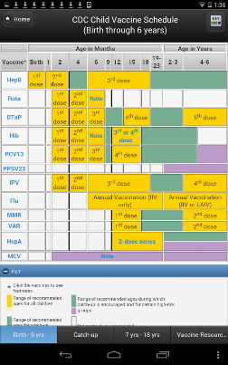
an APP a day keeps the doctor way
Notes:
Allison
Missing lap top on ippes
-internship
-family member s

Slide 22
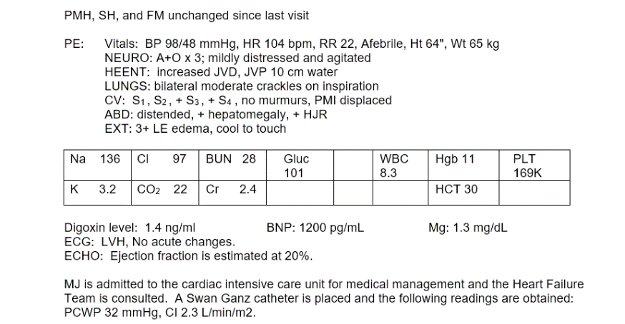
Having a difficult time finding out what all the acronyms mean in pharmacy school?
http://www.medilexicon.com/
Just type in an abbreviation → “search”
Medical-specific
Free
Notes:
Collin

Slide 23
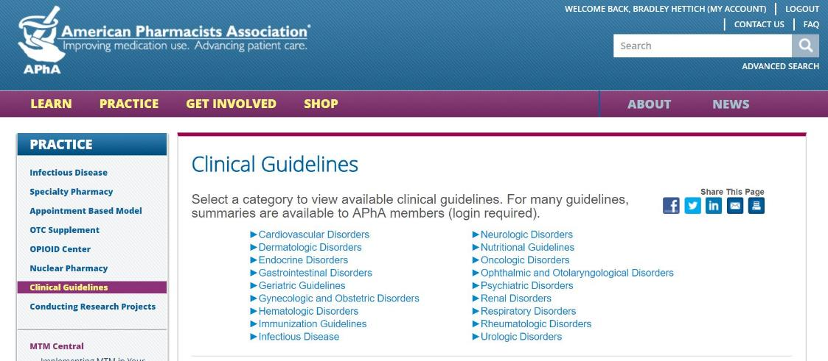
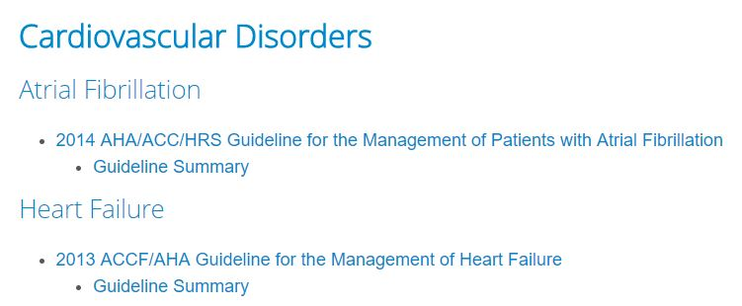
APhA Clinical Guidelines
Clinical Guidelines in one centralized location
Organized by disorder
Guideline Summary
Full downloadable PDF’s
http://www.pharmacist.com/clinical-guidelines
Notes:
Brad
Guideline summary useful to get an overview of where information is located (page numbers of specific content)
Full pdf’s are available
May be useful in 2nd year Drug Lit, 3rd and 4th year CI’s and for any rotations
- DO NOT GO THROUGH APhA site → Use pharmacist.com → search “clinical guidelines”

Slide 24
Emails
Notes:
Sydney

Slide 25
Thank You “Beary” Much Award
November 2017

Slide 26
Thank You “Beary” Much Award
Member of the Meeting Award
This koal-ity DPH-1 member has stepped up to the plate to fill in for Student Senate meetings whenever necessary and has also shown eagerness and enthusiasm to start planning future social events for all of WSPS!

Slide 27
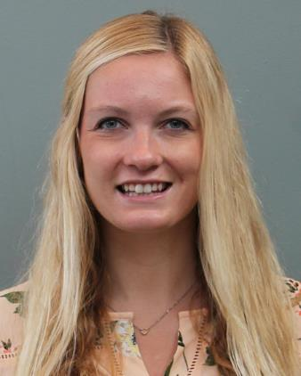
Thank You “Beary” Much Award
Thank you, Rachel!!
Rachel Kent
DPH-1

Slide 28
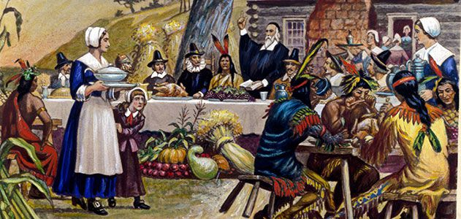
Access Code for Today
Notes:
-Also the year that Charles Darwin set voyage on the HMS Beagle
-First US eye hospital opened
-Maine became the 23rd state

Slide 29
Access Code for Today
1621

Slide 30
Go Packers!
General Reminders:
Board meeting in this room after this meeting – IE I’m kicking you out, sorry
See Karissa if you still need to sign up for WSPS
Last meeting of the semester is Thursday, December 7th at 5:30pm!
Thank you for coming!

