Slide 1
The Residency Match
November 11, 2019
Mara Kieser, MS, RPh

Slide 2
Outline
2019 ASHP match results
Types of residencies
National Matching Service
PhORCAS – Application Portal
How to prepare now - The big 4
Residency Timeline
Residency Costs
APPEs and the Match
Resources
Questions

Slide 3
2019 National Residency Match
Applicant Participation | PGY1 | Percent
Applicants enrolled in the match | 7105 | 100%
Applicants who withdrew or no rankings | 1168 | 16%
Applicants participating in the match | 5937 | 84%
Match Results | PGY1 | Percent
Applicants participating matched | 3822 | 64%
Applicants participating not matched | 2115 | 36%
https://natmatch.com/ashprmp/stats.html

Slide 4
2019 National Residency Match
PGY1 Programs | Total Programs | Total Positions | Filled
PGY1 | 1164 | 3359 | 3349
PGY1 Community | 218 | 282 | 274
PGY1 Managed Care | 49 | 79 | 78
PGY1&2 Community Admin / MS | 3 | 3 | 3
PGy1&2 Community Admin & Leader | 2 | 2 | 2
PGY1&2 Drug Information | 1 | 1 | 1
PGY1&2 Health System Admin / MS | 47 | 75 | 74
PGY1&2 Health System Admin & Leader | 15 | 20 | 20
PGY1&2 Pharmacotherapy | 10 | 13 | 13
PGY1&2 Pharmacy Informatics | 4 | 4 | 4
https://natmatch.com/ashprmp/stats.html

Slide 5
ASHP Residency Directory
https://accreditation.ashp.org/directory/#/program/residency

Slide 6
National Matching Service
https://natmatch.com/ashprmp/applicants/index.html

Slide 7
PhORCAS- Application Portal
https://portal.phorcas.org/

Slide 8
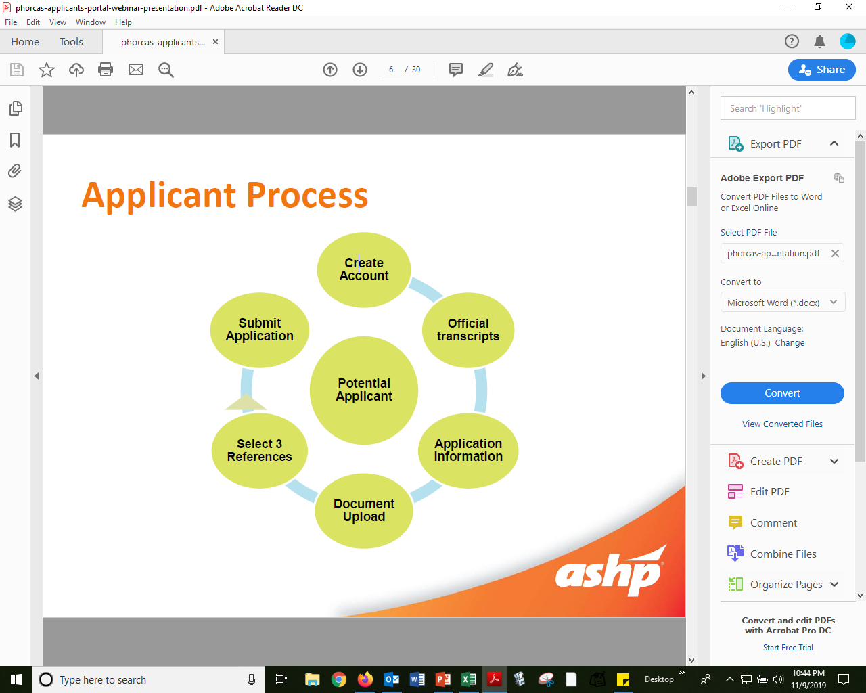
https://www.youtube.com/watch?v=9mBVvLXR17s&feature=youtu.be

Slide 9
How to Prepare Now
Four main areas
Grades - GPA > 3
Work experience
Leadership experience
Scholarship experience

Slide 11
2019 – 2020 Match Dates
Phase 2019-2020 | Deadline | Match Results
Phase I | February 28, 2020 | March 13, 2020
Phase II | April 1, 2020 | April 8, 2020
Scramble | April 9, 2020 | NA
Notes:
December 31, 2019 Recommended date by which applicants should register for the Match. February 1, 2020 By this date instructions for submitting Rank Order Lists and obtaining Match results will be provided to applicants and Program Directors registered to participate in the Match. February 10, 2020 + Add to Calendar
Beginning on this date applicants and programs can submit Rank Order Lists for Phase I of the Match. February 27, 2020 Final date on which applicants can register to participate in Phase I of the Match. February 28, 2020 + Add to Calendar
Phase I Rank Order List Deadline: Final date for submission of applicant and program Rank Order Lists for Phase I of the Match. No Rank Order Lists for Phase I of the Match can be accepted after this date. March 13, 2020 + Add to Calendar
Results of Phase I of the Match are released to applicants and Program Directors.
Program Directors must send letters of agreement, no later than April 12, 2020, to matched applicants who must sign and return the letters of agreement.
Positions available after Phase I of the Match is completed are offered to applicants who were not matched in Phase I through Phase II of the Match. The list of programs with available positions for Phase II of the Match is provided on this web site beginning at 12:00 p.m. noon ET.
Applicants who are not matched to a position in Phase I, as well as applicants who did not participate in Phase I, can use PhORCAS to prepare applications beginning on March 13 following release of the Phase I Match results.
March 17, 2020 + Add to Calendar
Beginning at 9:00 a.m. ET on this date, applicants who did not obtain a position in Phase I of the Match or who did not participate in Phase I of the Match can submit applications using PhORCAS to programs participating in Phase II of the Match. March 23, 2020 + Add to Calendar
Beginning on this date, applicants and programs can submit Rank Order Lists for Phase II of the Match. March 31, 2020 Final date on which applicants can register to participate in Phase II of the Match. April 1, 2020 + Add to Calendar
Phase II Rank Order List Deadline: Final date for submission of applicant and program Rank Order Lists for Phase II of the Match. No Rank Order Lists for Phase II of the Match can be accepted after this date. April 8, 2020 + Add to Calendar
Results of Phase II of the Match are released to applicants and Program Directors.
Program Directors must send letters of agreement, no later than May 8, 2020, to matched applicants who must sign and return the letters of agreement.
The list of programs with available positions for the Post-Match Process is provided on this web site beginning at 12:00 p.m. noon ET. No action to fill available positions, such as contacts or interviews between applicants and programs, is to be taken prior to 12:00 p.m. noon ET on April 8. Programs can update information on positions available in the Post-Match Process in the NMS Match System until May 31.
Applicants who do not obtain a position in the Match can use PhORCAS to prepare applications to programs in the Post-Match Process beginning on April 8, following release of the Phase II Match results.
April 9, 2020 + Add to Calendar
Beginning at 12:00 p.m. noon ET on this date, applicants who did not obtain a position in either Phase of the Match, or who did not participate in either Phase of the Match, can submit applications using PhORCAS to programs in the Post-Match Process. April 15, 2020 Recommended date for programs in the Post-Match Process to make offers to applicants.

Slide 12
2019 Residency Costs
Description 2019 | Cost
Register National Matching Service | $160
PhORCAS fee x 4 applications | $110
PhORCAS fee for each additional application* | $43
Travel – transportation, Airbnb, food | $$$$
*Average candidate applies to 10 sites; Average cost $1000+

Slide 13
APPEs and the Match
Block 2 – Update CV, identify letter writers
Block 3 – PSW Annual Meeting - Residency Showcase
Block 4 – UW Career Fair
Block 5 – Midyear (7 weeks)
Block 6 – interviews (avoid required APPEs if possible)
Block 7 – interviews (avoid required APPEs if possible)
Block 7 – Phase I results (Mid March)
Block 8 – Phase II results (April)
Notes:
December 31, 2019 Recommended date by which applicants should register for the Match.
February 1, 2020 By this date instructions for submitting Rank Order Lists and obtaining Match results will be provided to applicants and Program Directors registered to participate in the Match.
February 10, 2020 + Add to Calendar
Beginning on this date applicants and programs can submit Rank Order Lists for Phase I of the Match.
February 27, 2020 Final date on which applicants can register to participate in Phase I of the Match.
February 28, 2020 + Add to Calendar
Phase I Rank Order List Deadline: Final date for submission of applicant and program Rank Order Lists for Phase I of the Match. No Rank Order Lists for Phase I of the Match can be accepted after this date.
March 13, 2020 + Add to Calendar
Results of Phase I of the Match are released to applicants and Program Directors.
Program Directors must send letters of agreement, no later than April 12, 2020, to matched applicants who must sign and return the letters of agreement.
Positions available after Phase I of the Match is completed are offered to applicants who were not matched in Phase I through Phase II of the Match. The list of programs with available positions for Phase II of the Match is provided on this web site beginning at 12:00 p.m. noon ET.
Applicants who are not matched to a position in Phase I, as well as applicants who did not participate in Phase I, can use PhORCAS to prepare applications beginning on March 13 following release of the Phase I Match results.
March 17, 2020 + Add to Calendar
Beginning at 9:00 a.m. ET on this date, applicants who did not obtain a position in Phase I of the Match or who did not participate in Phase I of the Match can submit applications using PhORCAS to programs participating in Phase II of the Match.
March 23, 2020 + Add to Calendar
Beginning on this date, applicants and programs can submit Rank Order Lists for Phase II of the Match.
March 31, 2020 Final date on which applicants can register to participate in Phase II of the Match.
April 1, 2020 + Add to Calendar
Phase II Rank Order List Deadline: Final date for submission of applicant and program Rank Order Lists for Phase II of the Match. No Rank Order Lists for Phase II of the Match can be accepted after this date. April 8, 2020 + Add to Calendar
Results of Phase II of the Match are released to applicants and Program Directors.
Program Directors must send letters of agreement, no later than May 8, 2020, to matched applicants who must sign and return the letters of agreement.
The list of programs with available positions for the Post-Match Process is provided on this web site beginning at 12:00 p.m. noon ET. No action to fill available positions, such as contacts or interviews between applicants and programs, is to be taken prior to 12:00 p.m. noon ET on April 8. Programs can update information on positions available in the Post-Match Process in the NMS Match System until May 31.
Applicants who do not obtain a position in the Match can use PhORCAS to prepare applications to programs in the Post-Match Process beginning on April 8, following release of the Phase II Match results.
April 9, 2020 + Add to Calendar
Beginning at 12:00 p.m. noon ET on this date, applicants who did not obtain a position in either Phase of the Match, or who did not participate in either Phase of the Match, can submit applications using PhORCAS to programs in the Post-Match Process. April 15, 2020 Recommended date for programs in the Post-Match Process to make offers to applicants.

Slide 14
Resources
https://www.ashp.org/Professional-Development/Residency-Information/Student-Residency-Guide
https://accreditation.ashp.org/directory/#/program/residency
https://natmatch.com/ashprmp/applicants/index.html
https://www.ashp.org/Professional-Development/Residency-Information/Residency-Program-Directors/PhORCAS

Slide 15
Questions

Slide 16
Thank You!

Slide 17
The Residency Match
November 11, 2019
Mara Kieser, MS, RPh

